Slide 1
(No) trees
in phonology
EGG 2026
Brno, Czech Republic
Tobias Scheer

Slide 2
Rationale:
No Merge, no trees

Slide 3
no Merge, no trees
Scheer (2004: xliv, 2011: §§45f)
Scheer, Tobias 2013. Why phonology is flat: the role of concatenation and linearity. Language Sciences 39: 54-74.
Merge
morpho-syntax
  dominance and hence arboreal structure are the consequence of Merge, and of nothing else
  i.e. of the fact of drawing pieces from long term memory and gluing them together. This is called Merge.
phonology
  there is no Merge
  phonology does not access long term memory in order to retrieve pieces and glue them together
no Merge - no trees
this is put down in the basic generative architecture: the inverted T

Slide 4
no Merge, no trees
Chomsky (1965) et passim, overview Boeckx & Uriagereka (2007)
Lexicon 1
(synt. items)
morpho-syntax
concatenation (generative)
Lexicon 2
(phonol. items)
phonology
semantics
interpretative
(no concatenation)
Lexicon 3
(phonet. items)
phonetics
(grammatical)computation
physiology

Slide 5
no Merge, no trees
Chomsky, Noam. 1995. The Minimalist Program. MIT Press.
Chomsky, Noam, T. Daniel Seely, Robert C. Berwick, Sandiway Fong, M.A.C. Huybregts, Hisatsugu Kitahara, Andrew McInnerney & Yushi Sugimoto 2023. Merge and the Strong Minimalist Thesis. Cambridge: CUP.
Linearity
phonology
linearity is an input condition
morpho-syntax
leading minimalist insight (Chomsky 1995: 334, Chomsky et al. 2023):
linearity is not a property of syntax, which is only about hierarchy (i.e. trees).
it is imposed upon speech by interface conditions and therefore must not be part of the computational system that creates hierarchical structure.
linearity is thus an interface condition that must not be present in (narrow) syntax: it represents a separate computation that occurs post-syntactically and whose input is only hierarchical (trees), while its output is the linearized string that enters phonology.

Slide 6
Expression of hierarchy
Scheer, Tobias to appear. Advances in mathematical linguistics: phonology is flat. Linguistic Inquiry.
Merge and linearity are in complementary distribution
 | Merge | linearity
morpho-syntax | yes | no
phonology | no | yes

Slide 7
Expression of hierarchy
Scheer, Tobias to appear. Advances in mathematical linguistics: phonology is flat. Linguistic Inquiry.
causal relationships
  phonology has no trees because it does not merge anything
  lateral relations cannot exist in syntax in absence of linearity
Merge and linearity are necessary design properties of their respective modules
  there is no grammar (discrete infinity) without merging independently stored pieces
  there is no speech without linearity (in the vocal or signed modality)

Slide 8
Expression of hierarchy
Scheer, Tobias to appear. Advances in mathematical linguistics: phonology is flat. Linguistic Inquiry.
all areas of language have hierarchy
but which is expressed by different means according to the design properties of the environment:
  trees in syntax
  lateral relations in phonology

Slide 9
Expression of hierarchy
Lowenstamm, Jean 1996. CV as the only syllable type. Current Trends in Phonology. Models and Methods, vol. 2, edited by Jacques Durand & Bernard Laks, 419-441. Salford, Manchester: ESRI.
Scheer, Tobias 2004. A Lateral Theory of Phonology. Vol.1: What is CVCV, and why should it be? Berlin: Mouton de Gruyter.
Faust, Noam 2023. Metrically-conditioned syncope in Strict CV metrics. Glossa 8.
Faust, Noam & Shanti Ulfsbjorninn 2024. A footless stroll through Italian stress. The Linguistic Review 41, no 4.
trees and non-arboreal alternatives
area
arboreal
non-arboreal
syllable structure
onset-rhyme
Strict CV
Scheer, Tobias 2012. Direct Interface and One-Channel Translation. A Non-Diacritic Theory of the Morphosyntax-Phonology Interface. Vol.2 of A Lateral Theory of phonology. Berlin: de Gruyter.
D'Alessandro, Roberta & Tobias Scheer 2015. Modular PIC. Linguistic Inquiry 46: 593-624.
stress
feet
Strict CV Metrics
interface with morpho-syntax
prosodic constituency
Direct Interface
Kaye, Jonathan, Jean Lowenstamm & Jean-Roger Vergnaud 1985. The internal structure of phonological representations: a theory of Charm and Government. Phonology Yearbook 2: 305-328.
Schane, Sanford 1984. The fundamentals of particle phonology. Phonology Yearbook 1: 129-155.
Anderson, John & Colin Ewen 1987. Principles of Dependency Phonology. Cambridge: Cambridge University Press.
subsegmental structure
Feature Geometry
holistic primes:
Element Theory, Particle Phon., Dependency Phon.

Slide 10
Expression of hierarchy
Nespor, Marina 1999. Stress Domains. Word Prosodic Systems in the Languages of Europe, edited by Harry van der Hulst, 117-159. Berlin: Mouton de Gruyter.
 |  |  |  |  |  |  |  |  |  |  |  |  |  | U
 |  |  |  |  | IP
 |  | φ |  |  |  |  |  |  |  | φ
Cl |  |  |  |  |  |  | Cl |  |  | Cl |  |  |  | Cl
 |  |  |  |  |  |  | | |  |  |  |  |  |  | |
ω | ω |  | ω |  |  |  | ω |  | ω |  | ω |  |  | ω
| | | |  |  |  |  |  | | |  | | |  | |
Ft | Ft | Ft |  | Ft |  | Ft |  |  | Ft | Ft |  |  | Ft |  | Ft
| | | |  |  |  |  |  |  |  | |
σ | σ | σ | σ | σ | σ | σ | σ | σ | σ | σ | σ | σ | σ | σ | σ | σ
se | ti | manderanno |  |  |  | subito |  |  | le | ultime |  |  | cartoline,

Slide 11
Expression of hierarchy
four arguments
1. advances in mathematical linguistics: phonology is flat
target:
recursive trees
target:
recursive trees
2. trees overgenerate
3. burden of proof:
  the only evidence for trees in phonology (up to and excluding the Prosodic Word) is lateral in kind.
  this is then converted into arboreal structure.
target:
non-recursive trees
4. syllable structure
  patterns that lateral structure can, but arboreal structure cannot do: vowel-zero alternations, the Strong Position
target:
arboreal syllable structure

Slide 12
Argument #1
Evolution of
Mathematical Linguistics

Slide 13
Assessing computational complexity
mathematical linguistics has established that phonological patterns are less complex than syntactic patterns.
calculus of computational complexity: type of computation that is needed to map lexical onto surface forms.

Slide 14
Assessing computational complexity
Heinz, Jeffrey & William Idsardi 2011. Sentence and Word Complexity. Science 333: 295-297.
Heinz, Jeffrey & William Idsardi 2013. What complexity differences reveal about domains in language. Topics in Cognitive Science 5: 111–131.
Chandlee, Jane & Jeffrey Heinz 2017. Computational Phonology. Oxford Research Encyclopedia of Linguistics.
Heinz, Jeffrey 2018. The computational nature of phonological generalizations. Phonological Typology, edited by Larry Hyman & Frans Plank, 126-195. Berlin: de Gruyter Mouton.
computational complexity (amended Chomsky Hierarchy)
Recursively Enumerable
> Context-Sensitive
> Mildly Context-Sensitive
> Context-Free
> Regular
> Strictly Local
> Finite
syntax
phonology
before: syntax is Context-Free (or above), phonology is Regular or below
  "[c]apturing which patterns of words are well-formed sentences can require context-free or even mildly context-sensitive computations" Heinz & Idsardi (2011: 296).
  "all sound patterns fall into the 'regular' region (less restricted) of the Chomsky hierarchy, and probably belong to even less complex regions." Heinz & Idsardi (2011: 296)

Slide 15
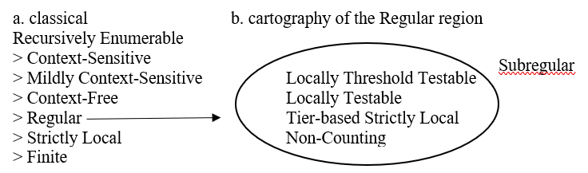
Assessing computational complexity
Heinz, Jeffrey 2009. On the rale of locality in learning stress patterns. Phonology 26: 303-351.
Heinz, Jeffrey 2010. Learning long-distance phonotactics. Linguistic Inquiry 41: 623-661.
Heinz, Jeffrey 2018. The computational nature of phonological generalizations. Phonological Typology, edited by Larry Hyman & Frans Plank, 126-195. Berlin: de Gruyter Mouton.
Graf, Thomas 2022. Subregular linguistics: bridging theoretical linguistics and formal grammar. Theoretical Linguistics 48: 145-184.
then the Regular region was cartographed (Heinz 2018)
it falls into a number of complexity patterns
example Tier-based Strictly Local: what is adjacent on autosegmental tiers
these are called Subregular: they are specific instantiations of Regular, and range above Strictly Local.
Heinz (2009, 2010, 2018) conjectures that phonology is Subregular in this sense: rather than using all Regular instruments, "phonological patterns belong to small, well-defined regions of regular stringsets and maps" Heinz (2018: 142).
overview: Graf (2022: 154-158)

Slide 16
Assessing computational complexity
Chomsky, Noam. 1995. The Minimalist Program. MIT Press.
Chomsky, Noam, T. Daniel Seely, Robert C. Berwick, Sandiway Fong, M.A.C. Huybregts, Hisatsugu Kitahara, Andrew McInnerney & Yushi Sugimoto 2023. Merge and the Strong Minimalist Thesis. Cambridge: CUP.
at that point, everybody assumed that syntax is a string language
  string language = outputs linear strings
  tree language = outputs trees
no linearity in syntax
  leading minimalist insight: linearity is not a property of syntax, which is only about hierarchy (i.e. trees).
  linearity is imposed upon speech by interface conditions and therefore must not be part of the computational system that creates hierarchical structure (Chomsky 1995: 334, Chomsky et al. 2023).
  linearity is thus an interface condition that must not be present in (narrow) syntax: it represents a separate computation that occurs post-syntactically. Its input is only hierarchical (trees), while its output is the linearized string that enters phonology.

Slide 17
Assessing computational complexity
Kayne, Richard S. 1994. The Antisymmetry of Syntax. Cambridge, Mass.: MIT Press.
Bobaljik, Jonathan 2002. A-Chains at the PF-Interface: Copies and ‘Covert’ Movement. Natural Language & Linguistic Theory 20: 197-267.
Richards, Marc 2004. Object Shift and Scrambling in North and West Germanic: a Case Study in Symmetrical Syntax. Ph.D dissertation, University of Cambridge.
Richards, Marc 2007. Dynamic Linearization and the Shape of Phases. Linguistic Analysis 33: 209-237.
Embick, David & Rolf Noyer 2007. Distributed Morphology and the Syntax - Morphology Interface. The Oxford Handbook of Linguistic Interfaces, edited by Gillian Ramchand & Charles Reiss, 289-324. Oxford: OUP.
Idsardi, William & Eric Raimy 2013. Three types of linearization and the temporal aspects of speech. Challenges to linearization, edited by Ian Roberts & Theresa Biberauer, 31-56. Berlin: Mouton de Gruyter.
linearization
Kayne's (1994) LCA (Linear Correspondence Axiom)
Bobaljik (2002)
Richards (2004, 2007)
Embick & Noyer (2007)
Idsardi & Raimy (2013)

Slide 18
syntax and phonology are equally complex, but…
Graf, Thomas 2022. Subregular linguistics: bridging theoretical linguistics and formal grammar. Theoretical Linguistics 48: 145-184.
Graf (2022)
section 4: "From strings to trees: subregular syntax"
"When viewed as a generator of string languages, syntax is at least mildly context- sensitive."
"But linguists have insisted for a long time that syntax is about trees, not strings."
"If we follow this credo and look at the complexity of tree languages instead of string languages, a subregular view of syntax may be more feasible. In fact, there is overwhelming evidence that syntax is subregular in this sense."
language as such is Subregular:
"[d]istinct language modules have the same complexity" (p.164)

Slide 19
syntax and phonology are equally complex, but…
Graf, Thomas 2022. Subregular linguistics: bridging theoretical linguistics and formal grammar. Theoretical Linguistics 48: 145-184.
Stabler, Edward 2019. Three Mathematical Foundations for Syntax. Annual Review of Linguistics 5: 243-260.
in other words
we always believed that syntax is more complex than phonology.
but this was when treating syntax as a string generator.
we missed out on the fact that syntax is not about generating strings, but about generating trees.
if we take trees into account, the computational complexity of syntax is demoted to the the complexity of phonology, i.e. sub-regular.

Slide 20
syntax and phonology are equally complex, but…
Graf, Thomas 2022. Subregular linguistics: bridging theoretical linguistics and formal grammar. Theoretical Linguistics 48: 145-184.
so in which way are syntax and phonology different?
before: they have different computational complexity
now: by what they generate: trees in syntax, linear strings in phonology
consequence: no trees in phonology
as we saw, generating linear strings on top of trees requires computational complexity of at least the Regular level.
but we know that phonology is only Subregular.
therefore phonology cannot have trees: if it did, it would cumulate string and tree language complexity, which we know is at least Regular.

Slide 21
syntax and phonology are equally complex, but…
 |  | output of computation
 |  | strings | recursive trees
at least Regular | (syntax: before) | yes | yes
Subregular | (syntax: now) | no | yes
Subregular | (phonology: now) | yes | no

Slide 22
syntax and phonology are equally complex, but…
evolution of the field
Heinz, Jeffrey 2023. What's new in mathematical linguistics. Paper presented at the NYI-5, January 20th.

Slide 23
syntax and phonology are equally complex, but…
evolution of the field
Heinz, Jeffrey 2023. What's new in mathematical linguistics. Paper presented at the NYI-5, January 20th.
Heinz, Jeffrey 2018. The computational nature of phonological generalizations. Phonological Typology, edited by Larry Hyman & Frans Plank, 126-195. Berlin: de Gruyter Mouton.

Slide 24
syntax and phonology are equally complex, but…
evolution of the field
Heinz, Jeffrey 2023. What's new in mathematical linguistics. Paper presented at the NYI-5, January 20th.
Stabler, Edward 2019. Three Mathematical Foundations for Syntax. Annual Review of Linguistics 5: 243-260.

Slide 25
syntax and phonology are equally complex, but…
evolution of the field
Heinz, Jeffrey 2023. What's new in mathematical linguistics. Paper presented at the NYI-5, January 20th.
Graf, Thomas 2022. Subregular linguistics: bridging theoretical linguistics and formal grammar. Theoretical Linguistics 48: 145-184.

Slide 26
Convergence
for a
flat phonology

Slide 27
phonology without trees
Raimy, Eric 2000. The phonology and morphology of reduplication. Berlin: Mouton de Gruyter.
Samuels, Bridget 2011. Phonological Architecture: A Biolinguistic Perspective. Oxford: OUP.
Mailhot, Frédéric & Charles Reiss 2007. Computing long-distince dependencies in vowel harmony. Biolinguistics 1: 28-48.
Nevins, Andrew 2010. Locality in Vowel Harmony. Cambridge, Mass.: MIT Press.
phonology without trees
Strict CV
rule-based approaches having developed lateral computation
  precedence relationships (e.g. Raimy 2000, Samuels 2011: 132ff)
  search and copy (Mailhot & Reiss 2007, Nevins 2010, Samuels 2011: 142ff, Andersson et al. 2020).
convergence for a flat phonology
from independent lines of thought: mathematical linguistics and phonology
where neither had the other on the radar

Slide 28
Scheer, Tobias 2023. Recursion in phonology: anatomy of a misunderstanding. Representing phonological detail. Volume 1: Segmental structure and representations, edited by Jeroen van de Weijer, 265-287. Berlin: de Gruyter.
Argument #2
Recursive trees
overgenerate

Slide 29
Overgeneration
Scheer, Tobias to appear. Advances in mathematical linguistics: phonology is flat. Linguistic Inquiry.
if phonology had access to a recursive tree-building device,
it is surprising that its complexity measure is stuck at the subregular level for the strings that are produced
 |  | output of computation
 |  | strings | recursive trees
at least Regular | (syntax: before) | yes | yes
Subregular | (syntax: now) | no | yes
Subregular | (phonology: now) | yes | no

Slide 30
Overgeneration
Neeleman, Ad & Hans van de Koot 2006. On syntactic and phonological representations. Lingua 116: 1524-1552.
Abstract
"This paper argues that phonological representations are not trees, but strings structured through boundary symbols.
Because trees are richer in information than strings, our main argument rests on a demonstration that tree-based phonology is too strong, in that it allows rules for which there is no empirical basis."
➔ overgeneration

Slide 31
Overgeneration
Neeleman, Ad & Hans van de Koot 2006. On syntactic and phonological representations. Lingua 116: 1524-1552.
"We discuss three contrasts between syntax and phonology that can be understood if phonology lacks trees.
The first is that syntax has recursive structures, whereas phonology does not.
The second is that syntax allows nonterminal nodes with feature content (as a result of percolation), but that no convincing case can be made for the feature content of putative nonterminal nodes in phonology.
Finally, syntactic dependencies are conditioned by c-command, while phonological dependencies are, by and large, conditioned by adjacency"

Slide 32
Overgeneration
Neeleman, Ad & Hans van de Koot 2006. On syntactic and phonological representations. Lingua 116: 1524-1552.
"The second and third difference between syntax and phonology can also be used to demonstrate that a treebased phonology is too weak,
in that independently motivated conditions on trees do not allow existing phonological rules."
➔ undergeneration

Slide 33
Overgeneration
Nespor, Marina 1999. Stress Domains. Word Prosodic Systems in the Languages of Europe, edited by Harry van der Hulst, 117-159. Berlin: Mouton de Gruyter.
illustration
Neeleman & van de Koot's point 2: no bottom-up labelling of nodes
also: the upper part of the tree comes out of nowhere: this is the only tree in language that is the projection of nothing.
 |  |  |  |  |  |  |  |  |  |  |  |  |  | U
 |  |  |  |  | IP
 |  | φ |  |  |  |  |  |  |  | φ
Cl |  |  |  |  |  |  | Cl |  |  | Cl |  |  |  | Cl
 |  |  |  |  |  |  | | |  |  |  |  |  |  | |
ω | ω |  | ω |  |  |  | ω |  | ω |  | ω |  |  | ω
| | | |  |  |  |  |  | | |  | | |  | |
Ft | Ft | Ft |  | Ft |  | Ft |  |  | Ft | Ft |  |  | Ft |  | Ft
| | | |  |  |  |  |  |  |  | |
σ | σ | σ | σ | σ | σ | σ | σ | σ | σ | σ | σ | σ | σ | σ | σ | σ
se | ti | manderanno |  |  |  | subito |  |  | le | ultime |  |  | cartoline,
projection from nothing
projection from lower items

Slide 34
There is no recursion in phonology
…but all of a sudden there is?

Slide 35
recursion all of a sudden
Pinker, Steven & Ray Jackendoff 2005. The faculty of language: what's special about it ? Cognition 95: 201-236.
it was once an established and uncontroversial fact that
there is recursion in syntax, but not in phonology
Nespor & Vogel (1986: 2), Kaye et al. (1990: 193), Hauser et al. (2002), Carr (2000: 90, 2006: 642ff), Idsardi (2018)
"Recursion consists of embedding a constituent in a constituent of the same type, for example a relative clause inside a relative clause (a book that was written by the novelist you met last night), which automatically confers the ability to do so ad libitum (e.g. a book [that was written by the novelist [you met on the night [that we decided to buy the boat [that you liked so much]]]]). This does not exist in phonological structure: a syllable, for instance, cannot be embedded in another syllable." (boldface added)
Pinker & Jackendoff (2005: 211)

Slide 36
recursion all of a sudden
Ladd, Robert 1986. Intonational phrasing: the case for recursive prosodic structure. Phonology 3: 311-340.
Selkirk, Elisabeth 1996. The prosodic structure of function words. Signal to syntax: bootstrapping from syntax to grammar in early acquisition, edited by James Morgan & Katherine Demuth, 187-213. Mahwah, NJ: Erlbaum.
Selkirk, Elisabeth. 1981. On the nature of phonological representation. In The cognitive representation of speech, edited by J. Anderson, J. Laver & T. Meyers, 379-388. North Holland.
then what authors call recursion entered through the door of the Prosodic Hierarchy
Ladd (1986) on intonation
in the new OT environment, Selkirk (1996) gives up on the Strict Layer Hypothesis (that banned recursion, Selkirk 1981) by demoting nonrecursivity to a violable constraint
since then the literature abounds in recursive analyses of higher items of the Prosodic Hierarchy: intonational phrases contain intonational phrases, prosodic words contain prosodic words, etc.

Slide 37
recursion all of a sudden
Hulst, Harry van der 2010. A note on recursion in phonology. Recursion and Human Language, edited by Harry van der Hulst, 301-341. Berlin: de Gruyter.
Smith, Norval 1999. A preliminary account of some aspects of Leurbost Gaelic syllable structure. The Syllable, Views and Facts, edited by Harry van der Hulst & Nancy Ritter, 577-630. Berlin, New York: de Gruyter.
Pöchtrager, Markus Alexander & Jonathan Kaye 2013. GP2.0. SOAS Working Papers in Linguistics and Phonetics 16: 51-64.
from there recursive structure was carried into
syllable structure
  recursion under the syllable node
  based on the idea that syllabic constituents are projections of Cs and Vs
  Smith (1999), van der Hulst (2010), GP2.0 Pöchtrager & Kaye (2013)

Slide 38
recursion all of a sudden
Nasukawa, Kuniya 2015. Recursion in the lexical structure of morphemes. Representing Structure in Phonology and Syntax, edited by Marc van Oostendorp & Henk van Riemsdijk, 211-238. Berlin: de Gruyter.
Hulst, Harry van der 2010. A note on recursion in phonology. Recursion and Human Language, edited by Harry van der Hulst, 301-341. Berlin: de Gruyter.
Vogel, Irene 2020. Life after the strict layer hypothesis. Prosodic studies. Challenges and prospects, edited by Hongming Zhang & Youyong Qian, 9-60. London: Routledge.
from there recursive structure was carried into
segmental structure
  nobody has argued that in a feature geometric tree, say, V-Place is dominated by another instance of V-Place, or that laryngeal prime dominates laryngeal⁰.
  save one exception: Nasukawa's Precedence-free Phonology where an Element, A for example, projects to A' and A''
survey of recursive structure in phonology:
van der Hulst (2010) (in the book he edited on recursion language).
Vogel (2012: 42ff, 2020: 19ff)
Nasukawa
(2015)

Slide 39
a misunderstanding
this is a misunderstanding
there is no recursion in phonology
recursion = self-embedding
  items A and B are embedded = one dominates the other (in a tree)
  they are of the same kind: a CP, DP, etc.
authors mistakenly believe that phonological structure is recursive when it is only embedding, i.e. never self-embedding:
  A and B have a dominance relation,
  but are not of the same kind.

Slide 40
One thing to get out of the way:
a "correct" definition of recursion

Slide 41
"correct" definition of recursion
Coolidge, Frederick L., Karenleigh A. Overmann & Thomas Wynn 2010. Recursion: what is it, who has it, and how did it evolve? WIREs Cognitive Science 2: 547-554.
large body of literature on what recursion is
different definition in different disciplines (math, logic, linguistics, comp. science)
Tomalin, Marcus 2011. Syntactic Structures and recursive devices: a legacy of imprecision. Journal of Logic, Language and Information 20: 297-315.
Tomalin (2011: 307) lists 9 distinct definitions of "recursion"
Lobina, David J. 2014. "A Running Back" and Forth: A Review of Recursion and Human Language. Biolinguistics 5: 151-169.
authors do an exegesis of Chomsky's work since the 50s to see whether his use of "recursion" is consistent over time.
Watumull, Jeffrey, Marc D. Hauser, Ian G. Roberts & Norbert Hornstein 2014. On recursion. Frontiers in Psychology 4, article 1017.
in this literature, when recursion as understood in linguistics is compared to what is held in the adult sciences, the linguistic conception is only ever the syntactic take.
"the notion of 'recursion' was fundamentally ambiguous when it began to be used by linguists in the 1950s, and […] these ambiguities have persisted to the present day. This unfortunate (and needless) perpetuation of imprecision has had a deleterious impact upon recent discussions of the role of recursion in linguistic theory." Tomalin (2011: 298)

Slide 42
"correct" definition of recursion
this debate is irrelevant for our purpose
when linguists talk about recursion in phonology, they want to know whether this alleged phonological recursion is the same, or comparable, to what we know form morpho-syntax: is the formal status of recursion the same on both sides?
given this question, it does not matter whether the word recursion is used "correctly" or according to mathematical or whatever other standards.
"recursion" is used here in order to refer to what syntacticians (mistakenly or not) believe it characterizes.
the goal is not to talk about words and their meaning or usage, but rather to
compare syntactic phenomena and analyses with their phonological counterparts.

Slide 43
"correct" definition of recursion
the definition of recursion in syntax is structural in kind
recursion is self-embedding: a structure is called recursive iff it contains two items, A and B, which meet two requirements:
  A and B are embedded (one dominates the other)
  they are of the same kind (two CPs, DPs, etc.).
Watumull, Jeffrey, Marc D. Hauser, Ian G. Roberts & Norbert Hornstein 2014. On recursion. Frontiers in Psychology 4, article 1017.
this is what Pinker & Jackendoff say (on the first slide):
"Recursion consists of embedding a constituent in a constituent of the same type, for example a relative clause inside a relative clause (a book that was written by the novelist you met last night), which automatically confers the ability to do so ad libitum (e.g. a book [that was written by the novelist [you met on the night [that we decided to buy the boat [that you liked so much]]]]). This does not exist in phonological structure: a syllable, for instance, cannot be embedded in another syllable." (italics in original)
Pinker & Jackendoff (2005: 211)

Slide 44
Recursive phenomena
vs.
recursive analyses of non-recursive phenomena

Slide 45
recursive phenomena vs. recursive analyses
cases of alleged phonological recursion are due to a decision made by the analyst, in presence of alternative analytical options.
there is some principle that needs to be obeyed
foot binarity
but data do not fit
trisyllabic word
is this a stray syllable?
or a ternary foot?
layered feet allow to respect foot binarity

Slide 46
recursive phenomena vs. recursive analyses
as far as I can see, this is the genesis of ALL cases of allegedly recursive structure in phonology
vd Hulst sees two motivations for recursive structure
  incorporation of stray items into an otherwise binary structure
  replicating syntactic structure (Structural Analogy)
Hulst, Harry van der 2010. A note on recursion in phonology. Recursion and Human Language, edited by Harry van der Hulst, 301-341. Berlin: de Gruyter.

Slide 47
recursive phenomena vs. recursive analyses
sub-syllabic recursion (syllable in a syllable)
as far as I can see, all recursive analyses of the syllable come from Levin (1985):
  applying X-bar structure to phonology
  the Rhyme in fact is a projection of the Nucleus, N'
  the syllable node is the max. projection N''
Levin, Juliette 1985. A Metrical Theory of Syllabicity. Ph.D dissertation, MIT.
Smith, Norval 1999. A preliminary account of some aspects of Leurbost Gaelic syllable structure. The Syllable, Views and Facts, edited by Harry van der Hulst & Nancy Ritter, 577-630. Berlin, New York: de Gruyter.

Slide 48
recursive phenomena vs. recursive analyses
Hulst, Harry van der 2010. A note on recursion in phonology. Recursion and Human Language, edited by Harry van der Hulst, 301-341. Berlin: de Gruyter.
vd Hulst adopts this view
  V projects Vrhy, then Vsyll
  word-final Cs are followed by an empty nucleus
  Cø# is a syllable, but cannot stand alone since its nucleus is empty
  therefore the small syllable Cø# is a dependent of the rhyme
"It is precisely this possibility that invokes the kind of recursion that is generally held impossible: a syllable inside a syllable." van der Hulst (2010: 309)

Slide 49
recursive phenomena vs. recursive analyses
nobody has ever seen a recursive phenomenon in phonology
the only thing we have seen are recursive analyses of non-recursive phenomena

Slide 50
recursive phenomena vs. recursive analyses
compare with morpho-syntax
recursive phenomena abound
they are recursive in a pre-theoretical or pre-analytical sense.
  Peter thinks [that John says [that Amy believes [that…]]]
clause in a clause
  Jil wants to read [[in the book [on the shelve]]
PP in a PP
  Czech dĕl-at "to do", dĕl-áv-at "to do repeatedly/often"
  dĕl-áv-áv-at "to do even more often"
morpheme repeated
here recursion owes nothing to any theoretical principle, or the avoidance of a violation thereof.
it is also independent of the choices or theoretical inclination of the analyst

Slide 51
recursive phenomena vs. recursive analyses
recursive analyses challenged in phonology, but not in syntax
given the purely analytic nature of recursion in phonology, recursive analyses of non-recursive phenomena may be challenged.
  against the recursion of PWds
Vigário (2010), Vogel (2012) and Downing & Kadenge (2020)
  "[t]he source for Tripura Bangla, Das 2001, shows that Tripura Bangla alternates binary, ternary, and quaternary stress and his analysis shows that none of it requires ternary feet".
Golston, Chris 2021. No stress system requires recursive feet. Catalan Journal of Linguistics 20: 9-35.
try to imagine an equivalent in syntax:
would anybody venture challenging the existence of recursive structure in syntax as such by proposing competing non-recursive analyses?
such attempts are absent because recursion is a linguistic fact in syntax, but only an analytic option in phonology.

Slide 52
recursive phenomena vs. recursive analyses
In morpho-syntax,
recursion is a fact about language
in phonology,
alleged cases of recursion are a fact about the analyst

Slide 53
Embedding and projection
≠
recursion

Slide 54
Embedding and projection ≠ recursion
in times when syntax had X-bar,
  items of the X-bar structure did not instantiate recursion
  they are embedded, but not self-embedded
X⁰, X' and XP are distinct items
  their domination properties are defined by their place in the X-bar structure
  X' can only be the mother of X⁰ and the daughter of XP, etc.
  these items are not interchangeable: none of them can occur anywhere else in the structure, or have any other mothers, sisters and daughters.
the relationship of items in an X-bar structure is one of projection, not recursion.

Slide 55
Embedding and projection ≠ recursion
recursion in syntax is quite different
  recursive structure involves two copies of the same item, here a CP
  both copies of the CP have the exact same domination properties
  they have the same mother, sister and daughter
  they may occur in the exact same positions in the tree

Slide 56
Embedding and projection ≠ recursion
all allegedly recursive structure in phonology mimics syntactic X-bar
phonologists mimic X-bar since Levin (1985)
  all allegedly recursive structures introduce recursion by "something prime"
  meaning that the prime item inherits properties that are projected from the lower item
McCarthy (1979: 453)
unlike in syntax, these items are not interchangeable because
  they are distinct items, not copies of the same item
  they have different domination properties
none of these items can occur anywhere else in the structure, or have any other mothers, sisters and daughters.
Nasukawa
(2015)
the names of the labels are interchangeable and do not matter (V_{rhy}, V_{syll}, V_{syl-ft}, V_{syl-cd})
van der Hulst (2010)

Slide 57
Embedding and projection ≠ recursion
Fukui, Naoki & Hiroki Narita 2014. Merge, labeling, and projection. The Routledge Handbook of Syntax, edited by Andrew Carnie, Yosuke Sato & Daniel Siddiqi, 3-23. New York: Routledge.
X-bar is out of fashion
in minimalist times, there is no X-bar anymore
individual Merge operations build constituents only if needed
there is no projection building "something prime" anymore
thus the phonological mimicking of syntactic X-bar structure is left without grounds

Slide 58
Embedding and projection ≠ recursion
Vigário, Marina 2010. Prosodic structure between the prosodic word and the phonological phrase: Recursive nodes or an independent domain? The Linguistic Review 27: 485-530.
Vogel, Irene 2012. Recursion in phonology? Phonological explorations. Empirical, theoretical and diachrnic issues, edited by Bert Botma & Roland Noske, 41-61. Berlin: de Gruyter.
Vogel, Irene 2020. Life after the strict layer hypothesis. Prosodic studies. Challenges and prospects, edited by Hongming Zhang & Youyong Qian, 9-60. London: Routledge.
Embedding and projection ≠ recursion
this is pointed out elsewhere
Downing, Laura & Maxwell Kadenge 2020. Re-placing PStem in the prosodic hierarchy. The Linguistic Review 37: 433-461.
Golston, Chris 2021. No stress system requires recursive feet. Catalan Journal of Linguistics 20: 9-35.

Slide 59
Unlimited depth of recursion

Slide 60
unlimited depth in syntax, but not in phonology
Watumull, Jeffrey, Marc D. Hauser, Ian G. Roberts & Norbert Hornstein 2014. On recursion. Frontiers in Psychology 4, article 1017.
in syntax, recursion is unlimited in its depth
  nothing in the operation of self-embedding imposes any limits
Stabler, Edward P. 2014. Recursion in Grammar and Performance. Recursion: Complexity in Cognition, edited by Tom Roeper & Margaret Speas, 159-177. London: Springer.
Koopman, Hilda 2014. Recursion Restrictions: Where Grammars Count. Recursion: Complexity in Cognition, edited by Tom Roeper & Margaret Speas, 17-38. London: Springer.
  restrictions on the depth of recursion are rooted in factors that lie outside of grammar, such as memory
if phonological recursion were real, it would be expected to also have this property. But it does not.
  the depth of phonological recursion is implicitly or explicitly restricted to one or two levels
  but never for grammar-external reasons as in morpho-syntax
  instead, grammar-internal reasons are invoked

Slide 61
unlimited depth in syntax, but not in phonology
Martínez-Paricio, Violeta & René Kager 2015. The binary-to-ternary rhythmic continuum in stress typology: Layered feet and nonintervention constraints. Phonology 32: 459-504.
Most often authors call a given structure recursive but do not address the question why the maximum depth of the particular recursive item is one
some authors explicitly set a limit of recursion, to one level of depth.
some authors call on X-bar, which has a maximal projection, i.e. limiting embedding of ω and Φ to two levels.
Itô, Junko & Armin Mester 2013. Prosodic subcategories in Japanese. Lingua 124: 20-40.
overgeneration…?
  "as Schiering et al. (2010: 699) argue, recursion is far too powerful. It predicts an unlimited number of subphrasal domains, whereas far fewer are robustly attested." Downing & Kadenge (2020: 455)
  imagine a syntactician arguing that recursion of, say, CP, needs to be restricted because unlimited recursion overgenerates, i.e. produces many more layers than what is supported by the empirical record.
Downing, Laura & Maxwell Kadenge 2020. Re-placing PStem in the prosodic hierarchy. The Linguistic Review 37: 433-461.

Slide 62
No concatenation, no trees
No trees, no recursion

Slide 63
no trees, no recursion
morpho-syntax
  dominance and hence arboreal structure are the consequence of concatenation, and of nothing else
  i.e. of the fact of drawing pieces from long term memory and gluing them together. This is called Merge.
phonology
  there is no concatenation
  phonology does not access long term memory in order to retrieve pieces and glue them together
Scheer (2004: xliv, 2011: §§45f)
Scheer, Tobias 2013. Why phonology is flat: the role of concatenation and linearity. Language Sciences 39: 54-74.
this is the basic generative architecture: the inverted T
no concatenation - no trees
no no trees - recursion

Slide 64
Argument #3
Burden of proof
(non-recursive trees)

Slide 65
Non-recursive trees
if there are no recursive trees in phonology,
a logical possibility is that phonology does express hierarchy in terms of trees,
but which are distinct in kind from the arboreal structure found in syntax:
they would not be the result of Merge, and therefore non-recursive.
this description corresponds to traditional arboreal structure in phonology before recursive trees appeared in Ladd (1986).
the very existence of such trees contrasts with the fact that phonologists of all persuasions constantly take morpho-syntactic trees as a reference for phonological trees.

Slide 66
Syllable structure:
the lateral alternative

Slide 67
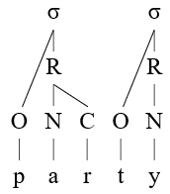
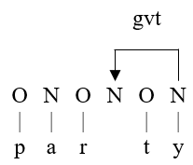
Ségéral, Philippe & Tobias Scheer 2008. The Coda Mirror, stress and positional parameters. Lenition and Fortition, edited by Joaquim Brandão de Carvalho, Tobias Scheer & Philippe Ségéral, 483-518. Berlin: Mouton de Gruyter.
The lateral alternative
the coda
want to know who you are?
arboreal
coda r: C that pertains to the coda constituent
onset p,t: C associated to an onset constituent
onset/coda then determines segmental phenomena:
coda consonants are weak and typically experience lenition (for instance, coda r will not be pronounced in non-rhotic varieties of English), while onset consonants do not (onset r is pronounced in all varieties of English).
look up
lateral
coda r: C occurring before a governed empty nucleus
onset p,t: C occurring before a contentful nucleus
look right

Slide 68
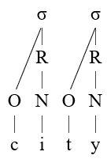
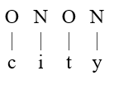
The lateral alternative
open vs. closed syllable
look up
arboreal
a stands in a closed syllable because it is followed by a coda
i stands in an open syllable because it is not followed by a coda
want to know who you are?
lateral
a stands in a closed syllable because the following nucleus is empty
look right
i stands in an open syllable because the following nucleus is contentful

Slide 69
The lateral alternative
deforestation
Strict CV
constituent structure is universal whereby every onset is followed by a nucleus and every nucleus is followed by an onset (where neither branches). Whence the name of the theory.
lateral relations
hierarchy is expressed in terms of lateral relations that have a head and a dependent
  government
  licensing
functional equivalent
structure and causality are lateral
syllabic trees are thus replaced by the
lateralization of structure: empty syllabic constituents
and causality: lateral relations, i.e. computation

Slide 70
Syllable structure
is lateral in kind

Slide 71
Steriade, Donca 1982. Greek Prosodies and the Nature of Syllabification. MIT.
Blevins, Juliette 1995. The Syllable in Phonological Theory. The Handbook of Phonological Theory, edited by John Goldsmith, 206-244. Oxford, Cambridge, Mass: Blackwell.
Syllabification algorithm
Phonology 101 everywhere in the world
syllable structure is a function of 2 and only 2 factors:
  the linear order of segments
  their relative sonority
  (plus parameters: codas allowed or not, etc.)
relative
means lateral: the analyst needs to compare the sonority of adjacent items, in order to discover the sonority slope.
syllable structure is thus governed by sonority sequencing (among many others, Steriade 1982: 72ff, Blevins 1995: 221ff)

Slide 72
Syllabification algorithm
conversion of lateral information into arboreal structure
this primary lateral information is then converted into trees
the fact that a consonant "belongs" to a vowel is interpreted in arboreal terms: the vowel and the consonant are dominated by the same arboreal constituent.
in party, the r belongs to the preceding, but the t to the following vowel

Slide 73
Syllabification algorithm
Scheer, Tobias to appear. Lateral relations in phonology. The Cambridge Handbook of Phonology, 2nd edition, edited by Adam Jardine & Paul de Lacy. CUP.
burden of proof
lateral relations are thus the primary currency of syllable structure.
zero hypothesis: syllable structure is lateral, i.e. syllabic generalizations are expressed in terms of lateral relations
non-lateral approaches have to accept the burden of proof
  they need to explain why the lateral solution falls short of theory or fact, or why another interpretation, arboreal in kind, fares better.
  in absence of such arguments, there is no rationale for an unnecessary detour through trees.

Slide 74
Syllabification algorithm
Levin, Juliette 1985. A Metrical Theory of Syllabicity. Ph.D dissertation, MIT.
mimicking syntax
tacit, unmotivated and unquestioned assumption running in phonology in structuralist (Fudge 1969) and in generative quarters since the reintroduction of the syllable by Kahn (1976):
expressing hierarchy in terms of trees is universal, or at least the only way used by language.
if this is how syntax works, phonology must follow.
this is sometimes made explicit: Levin’s (1985) syllable mimicking X-bar.

Slide 75
Syllabification algorithm
not unreasonable
to believe that there is only one expression of hierarchy in language
that phonologists are well advised to mimic more advanced syntactic structure
especially in times when there was no articulated lateral alternative.
but now that
we have looked at what syllable structure originates in
we have understood that syntax and phonology are fundamentally different: syntax has Merge but no linearity, phonology has no Merge but linearity
there is a lateral alternative
… there is good reason to stop mimicking syntax

Slide 76
Scheer, Tobias. to appear. Lateral relations in phonology. In The Cambridge Handbook of Phonology, 2nd edition, edited by Adam Jardine & Paul de Lacy. CUP.
Argument #4
Patterns that lateral structure can,
but arboreal structure cannot do

Slide 77
Vowel-zero alternations
and their arboreal analysis

Slide 78
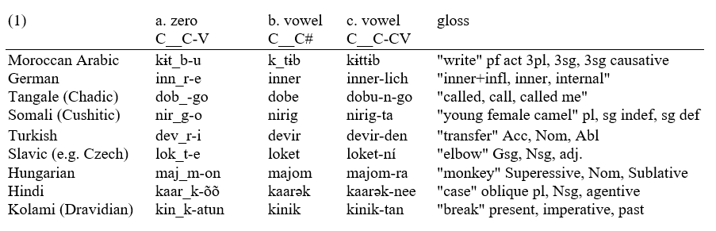
vowel-zero alternations

Slide 79
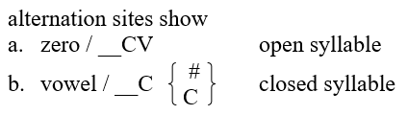
vowel-zero alternations

Slide 80

vowel-zero alternations
analysis
t is a coda in loket ➔ vocalization in closed syllables
but an onset in lok_t-e ➔ no vocalization in open syllables
thus t is resyllabified
the arboreal analysis necessarily involves resyllabification
there is no arboreal analysis without resyllabification

Slide 81
Alternative lateral analysis

Slide 82
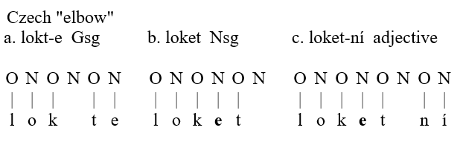
vowel-zero alternations
Emonds, Joseph. 1972. Evidence That Indirect Object Movement Is a Structure-Preserving Rule. Foundations of Language 8.546-561.
Bresnan, Joan. 1978. A realistic transformational grammar. In Linguistic theory and psychological reality, edited by Morris Halle, Joan Bresnan & G. A. Miller, 1-59. MIT Press.
alternative analysis
following structure preservation in syntax (Emonds 1972, Bresnan 1978),
it considers that constituent structure remains unmodified when the terminals happen to be absent.
thus in a vowel-zero alternation, the nucleus hosting the vowel continues to exist when the vowel happens to be absent: it is then empty.

Slide 83
vowel-zero alternations
no resyllabification: consequences
permanence of the empty nucleus under a)
the root-final -t is an onset in all forms of the word: it could not be an onset under a), but a coda under b),c).
since onsets cannot occur without nuclei, this in turn mandates the existence of an empty nucleus
  following the word-final -t under b)
  and following the preconsonantal t under c)

Slide 84
"In open syllables except if the following vowel alternates with zero"

Slide 85
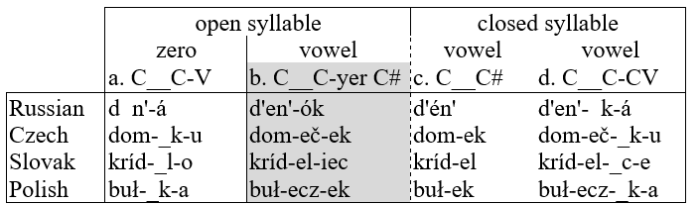
vowel-zero alternations
slight complication
in Slavic, vowels do not only occur in closed syllables c), d),
but also in open syllables IFF the following vowel alternates with zero itself: b)
why is the alternation site zero when followed by a stable vowel a), but vocalized when followed by an alternating vowel (called yer in Slavic)?
in both cases, the alternation site occurs in the surface context __CV (open syllable).

Slide 86
vowel-zero alternations
__CV alternation site is zero if V is stable
__CV alternation site is vocalized if V is alternating with zero itself
what distinguishes the two contexts is not (arboreal) syllable structure, but rather the kind of item that occurs in the following nucleus: a stable a) vs. an alternating vowel b).

Slide 87
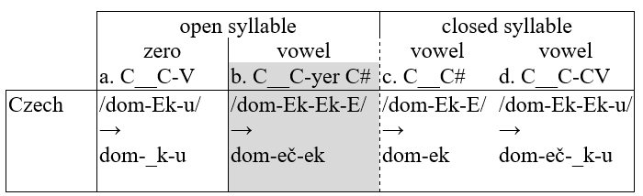

vowel-zero alternations
Lightner, Theodore. 1965. Segmental Phonology of Contemporary Standard Russian. Doctoral dissertation, Ph.D. dissertation, MIT.
Gussmann, Edmund. 1980. Studies in Abstract Phonology. MIT Press: Cambridge Mass.
Rubach, Jerzy. 1984. Cyclic and Lexical Phonology: The Structure of Polish. Foris: Dordrecht.
Hyman, Larry. 1985. A Theory of Phonological Weight. Foris: Dordrecht.
Kenstowicz, Michael & Jerzy Rubach. 1987. The Phonology of Syllabic Nuclei in Slovak. Language 63.463-497.
Bethin, Christina. 1998. Slavic Prosody. Language change and phonological theory. Cambridge University Press: Cambridge.
since Lightner (1965), the generative analysis of Slavic vowel-zero alternations has therefore identified the following yer as the trigger of the vowel-zero alternation
the pattern then obeys the rule called Lower
an underlying yer is promoted to surface existence if and only if followed by another (underlying) yer, no matter whether the yers at hand are eventually pronounced or not.

Slide 88
Lower
is a lateral relation

Slide 89
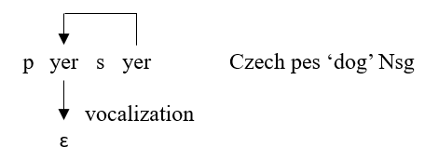
vowel-zero alternations
Lower is a lateral relation
instead of relying on a causal relationship between arboreal syllable structure and the vocalization of alternation sites, Lower thus describes a lateral relation between vowels.
the only information which is needed in order to compute the phonetic value of alternation sites concerns the following vowel, which is either an alternating (yer) or a stable vowel (non-yer). In the former case, the alternation site is vocalized, in the latter it is not.
the insight from the Slavic pattern is thus that vowel-zero alternations are the result of a regressive (right-to-left) intervocalic relationship: the patient is the leftmost vowel, whose phonetic value is determined by its neighbor to the right.

Slide 90
vowel-zero alternations
Lower is a lateral relation
in complete independence of Government Phonology (GP), which did not exist when Lightner (1965) or Gussmann (1980) wrote,
the Slavic pattern of vowel-zero alternations has thus prompted an analysis whereby the reason for the vowel or the zero to appear is a lateral relationship with the following vowel,
and where arboreal syllable structure plays no role
In GP, this lateral relationship is called government.

Slide 91
vowel-zero alternations
emancipating the pattern from Slavic and the Slavic-specific term yer:
alternating vowels are underlyingly floating
identical vowels sometimes alternate with zero, at other times they do not
  pes - p_s-a "dog Nsg, Gsg"
  les - les-a "forest Nsg, Gsg"
being stable or alternating is thus an unpredicatable lexical property of vowels, which must be encoded in the lexicon:
  stable vowels are lexically associated to their nucleus,
  while alternating vowels are lexically floating.

Slide 92
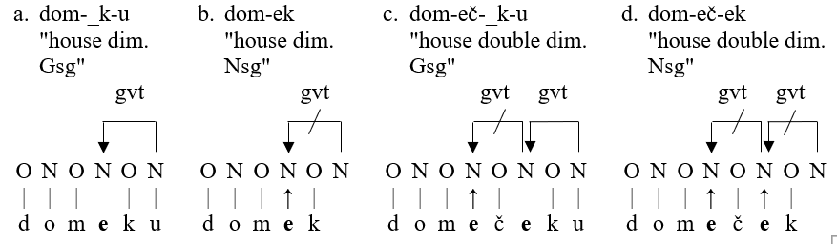
vowel-zero alternations
Scheer, Tobias. 2004. A Lateral Theory of Phonology. Vol.1: What is CVCV, and why should it be? Mouton de Gruyter: Berlin.
Ségéral, Philippe & Tobias Scheer. 2008. The Coda Mirror, stress and positional parameters. In Lenition and Fortition, edited by Joaquim Brandão de Carvalho, Tobias Scheer & Philippe Ségéral, 483-518. Mouton de Gruyter.
government (definition)
government inhibits the segmental expression of its target.
only contentful nuclei can govern.

Slide 93
vowel-zero alternations
works all fine, except for d), which should be just like c)
recall that there is a crucial difference between cases where an alternating vowel
  is followed by a stable vowel a) (zero surfaces)
  and where it is followed by a (pronounced) alternating vowel d)
cast in lateral terms, this means that stable vowels are good governors, but alternating vowels are not, even if they are pronounced as under d)

Slide 94
vowel-zero alternations
Grammont, Maurice. 1914. Traité pratique de prononciation française. Delgrave: Paris.
Kaye, Jonathan. 1990. Government in phonology: the case of Moroccan Arabic. The Linguistic Review 6.131-159.
Hall, Tracy. 1992. Syllable Structure and Syllable-Related Processes in German. Niemeyer: Tübingen.
whether or not (pronounced) alternating vowels
can govern turns out to be a parameter
no in modern Slavic languages
yes in Old Czech and Old Polish
  Mod. Czech dom-eč-ek Old Czech dom-_č-ek
  Mod. Polish pies-ek "dog dim. Nsg" Old Polish p_s-ek
other languages side with Old Czech and Old Polish, among which
Moroccan Arabic (Kaye 1990)
German (e.g. Hall 1992)
French: loi des 3 consonnes (Grammont 1914) je ne te le redemande pas
  "any schwa may be dropped provided the result thereof is not a sequence of three consonants"

Slide 95
beyond Slavic:
alternating vowels are also unable to open the preceding syllable outside of Slavic

Slide 96
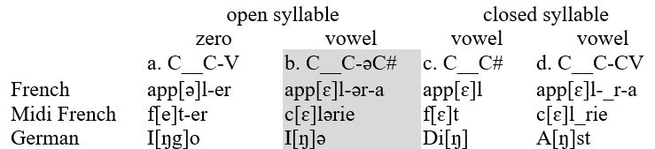
vowel-zero alternations
Scheer, Tobias. 2004. A Lateral Theory of Phonology. Vol.1: What is CVCV, and why should it be? Mouton de Gruyter: Berlin.
Scheer, Tobias. 2006. How yers made Lightner, Gussmann, Rubach, Spencer and others invent CVCV. In Studies in Constraint-based Phonology, edited by Piotr Bański, Beata Łukaszewicz & Monika Opalińska, 133-207. Wydawnictwo Uniwersytetu Warszawskiego.
the pattern "in open syllables except if the following vowel alternates with zero" is quite specific, but nothing specifically Slavic (Scheer 2004: §426, 2006):
it occurs in other languages
its effect may as well be seen on consonants (rather than on vowels)

Slide 97
vowel-zero alternations
take-home
in some languages, vowels which alternate with zero
  are unable to influence the preceding vowel: modern Slavic, French, Midi French
  or consonant: German
even when they are pronounced, they behave as if they were not there
  that is, like if the preceding vowel stood in a closed syllable, or the preceding consonant, in a coda

Slide 98
Evidence for the
absence of resyllabification

Slide 99
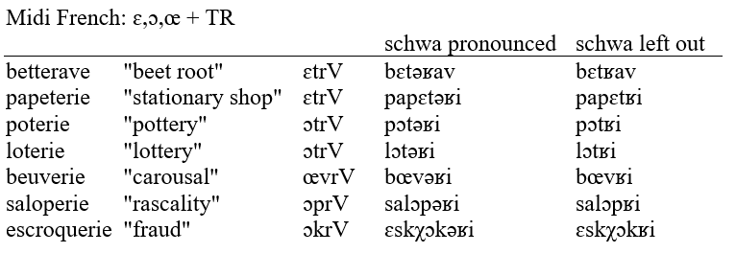
vowel-zero alternations
the preceding mid vowel is entirely unimpressed by whatever consonant cluster is produced to its right when schwa is left unpronounced:
it remains -ATR also before TR clusters: *[be.tʁav]
there was no resyllabification
resyllabification makes the wrong prediction

Slide 100
vowel-zero alternations
recall:
analysis
t is a coda in loket ➔ vocalization in closed syllables
but an onset in lok_t-e ➔ no vocalization in open syllables
thus t is resyllabified
the arboreal analysis necessarily involves resyllabification
there is no arboreal analysis without resyllabification

Slide 101
Consequences

Slide 102
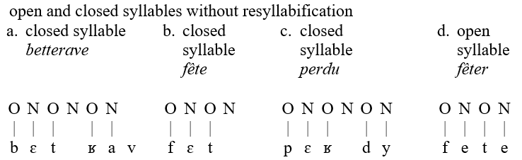
vowel-zero alternations
no resyllabification = T and R are separated by an empty nucleus [bɛt_ʁav] a)
but then, how does the mid vowel ɛ stand in a closed syllable?
recall that -ATR mid vowels occur in closed, +ATR mid vowels in open syllables
compare ɛ in a) and e in d): this is the difference between a closed and an open syllable:
  vowel in closed syllable = occurs before an empty nucleus
  vowel in an open syllable = occurs before a filled nucleus

Slide 103
vowel-zero alternations
occurring before an empty or a filled nucleus is also what makes the difference between a coda and an onset consonant:
  the t under a) is a coda consonant since it "closes" the preceding syllable, while the t under d) is an onset consonant.
  onset consonants occur before filled
  coda consonants before empty nuclei

Slide 104
vowel-zero alternations
thus definition of basic syllabic objects:
open vs. closed syllable
  A vowel stands in an open syllable if and only if the following nucleus is contentful. It occurs in a closed syllable if and only if it is followed by an empty nucleus.
onset vs. coda
  Onset consonants are followed by a contentful nucleus, while coda consonants are followed by an empty nucleus.

Slide 105
vowel-zero alternations
these definitions mandate the syllabic identity
of word-final consonants under b): they must also be onsets of empty nuclei since they are preceded by -ATR vowels
of the ʁ under c): they must also be onsets of empty nuclei
  which unlike the coda consonant t under a) is not followed by an alternation site:
  no vowel is ever surfacing in the midst of the cluster in [pɛʁdy] (while the cluster in [bɛtʁav] may be broken up by schwa: [bɛtəʁav]).

Slide 106
vowel-zero alternations
we have now derived the syllabic environment of Strict CV
there is no coda constituent anymore (codas are consonants that occur before an empty nucleus)
thus there is no rhyme or syllable node anymore either
➔ syllabic constituency boils down to a sequence of onset-nucleus pairs, called CV units.
lateral relations (government and licensing) embody the lateral relations at hand:
  coda consosonants occur before an empty nucleus
  vowels in closed syllables occur before an empty nucleus
but that's for another time.

Slide 107
That's all

