Slide 1
Basics of Ellipsis
Idan Landau
EGG 2026, Brno

Slide 2
• Form-meaning mismatches
• Ellipsis constructions
• Deep anaphora vs. surface anaphora
• Evidence for silent structure: agreement
• Null N vs. NP-ellipsis
• Connectivity effects: case, selection, concord
• Evidence for silent structure: Extraction and island sensitivity
• Licensing VP ellipsis, NP ellipsis and sluicing
• The [E]-feature
• Recoverability of Deletion
• φ-match and φ-mismatch in NP-ellipsis
• Syntactic or semantic identity? strict/sloppy readings, vehicle change, polarity mismatch, voice mismatch
• Further challenges to identity
• V-stranding VP ellipsis vs. Argument Ellipsis
Topics

Slide 3
On the common view that PF is the interface of syntax to morpho-phonology, and LF is the interface to semantics-pragmatics, the grammar is modular. This modularity ensures that PF and LF do not directly “communicate”.
→ The existence of form-meaning mismatches is inevitable, despite its cost in functionality, because no grammatical mechanism can guarantee a full match between separate modules.
Uninterpreted form (more form than meaning)
(1) a. There is going to be a problem. Expletive b. He examined the patient / the examination of the patient Dummy prepositions c. Hanako-ga ringo-o tabe-ta. Case particles (Japanese)
Hanako-NOM apple-ACC ate-PST
‘Hanako ate an apple.’
Form-meaning mismatches I

Slide 4
Uninterpreted form (more form than meaning)
(2) a. Mimi ni-li-kuwa ni-ngali ni-ki-fanya kazi. Agreement morphology (Swahili)
I 1SG-PST-be 1SG-still 1SG-PERF-do work
‘I am still working.’ b. le’hodot ba-ašma hem lo hodu. Doubled elements (Hebrew) to.admit in.the-guilt they not admitted.3PL
‘Plead guilty, they didn’t.’ f. Tol’ko, požalujsta, poka ne govori nikomu ničego! Negative concord (Russian) only please yet NEG tell nobody.DAT nothing.GEN
‘But please do not tell anybody anything yet!’ / * ‘But please do not tell nobody nothing!’
If “more form than meaning” does not surprise us, then “more meaning than form” should not surprise us either. Ellipsis is just one kind of “more meaning than form”.
Form-meaning mismatches II

Slide 5
Unpronounced meaning (more meaning than form): Two modes
In one mode of interpreting "missing" material (pragmatic inference), the material is not present at all at the syntactic level, and the interpretation is flexible and indeterminate. In another mode (ellipsis), the missing material is present at some syntactic level and the interpretation is severely constrained by the grammar.
(2) - When do you move out?
- We don’t have a permit yet.
→ to move out / to rennovate / to sign a lease / to get a job here / etc…
(3) - When do you move out?
- We don’t know yet when.
→ we move out / *we rennovate / *we sign a lease / *we get a job here / *…
Question: How does the grammar decide which way to use in which context?
Answer: That’s an open research question. A useful intuition is that contexts involving obligatory selection and still remain unfilled are those that exhibit ellipsis.
Form-meaning mismatches III
Pragmatic inference
Ellipsis

Slide 6
(4) a. VP-ellipsis: Paul should visit Norway but Mary should not visit Norway. b. Pseudogapping: Paul should visit Norway and Mary should Sweden_{i} visit t_{i}. c. Gapping: Paul visited Norway, and Mary, visited Sweden. d. Predicate ellipsis: Ben will be in the garden although he’d rather not be in the garden. e. Sluicing: She mentioned somebody, I can’t remember who she mentioned. f. Fragments answers: A: What did they take? B: My jewels, they took. g. Stripping: She likes comedies, and horror movies, she like too / … but not thrillers, she likes h. NP-ellipsis: She has so many teenage fans while he only has a few teenage fans. i. Argument ellipsis: ata ulay karata harbe ma’amarim. Ani katavti harbe ma’amarim. (Hebrew)
You maybe read.2SG many articles I wrote/1SG
‘You may have read many articles. I wrote many article.’
Ellipsis not only involves silent syntax (evidence coming up shortly) but requires an explicit linguistic antecedent.
Ellipsis constructions

Slide 7
In a seminal paper published exactly 50 years ago, H&S compared two opposite approaches to anaphora and claimed that they are both true for different anaphoric elements. The major contribution of the paper was in identifying and demonstrating a cluster of empirical properties associated with each type.
(5) Strict transformational view
All anaphoric elements – whether null or overt – result from deletion of fully syntactic constituents, under identity with a linguistic antecedent. The deletion or conversion to pronoun occurs "late" in the derivation – that is, right before pronunciation (the anaphor appears only on the “surface”).
(6) Strict interpretive view
No anaphoric elements – whether null or overt – result from deletion; they are all present at D-structure exactly as they appear in pronunciation (the anaphor is “deep”). The association of the gap/pronoun with its antecedent is achieved by a late interpretive rule.
Surface anaphor → rich syntax, simple semantics; deep anaphor → simple syntax, rich semantics
Deep vs. surface anaphora: Hankamer & Sag 1976

Slide 8
Surface anaphora: Content identified by a linguistic antecedent.
(5) [Hankamer attempts to stuff a 9-inch ball through a
6- inch hoop]
Sag: #It's not clear that you'll be able to [_{VP} e].
(6) Hankamer: I'm going to stuff this ball through this hoop.
Sag: It's not clear that you'll be able to [_{VP} e].
(7) [In a wine store, looking at a row of bottles]
Customer: * Can I taste each [_{NP} e ]?
(8) Seller: This is our recent selection of wines.
Customer: Can I taste each [_{NP} e ]?
(9) [Thinking who would be interesting to interview]
You: * I know who [_{TP} e ].
(10) A: I wonder who we should interview.
B: I know who [_{TP} e ].
Antecedence of the two types of anaphora
Deep anaphora: Content identified by a pragmatic antecedent (possibly but not necessarily linguistic).
(11) [Same context]
Sag: It's not clear that you'll be able to do it.
(12) [Same context]
Customer: Can I taste each one?
(13) [Same context]
You: I know! (Null Complement Anaphora)

Slide 9
The material inside an ellipsis site interacts syntactically with material outside: Agreement and Extraction.
(11) a. I didn’t think there would be many linguists at the party, but there were/*was. b. I didn’t think there would be a linguist at the party, but there *were/was.
Note: This is VPE – the elided VP is headed by a trace of the auxiliary:
[_{TP} there [_{Tˡ} [were_{i} T] [_{VP} t_{i} many linguists at the party]]]
(12) Compré la falda negra y la falda amarilla. (Spanish; but maybe amarilla is “converted” to N?)
Bought.1SG the skirt black and the yellow.F.SG
‘I bought the black skirt and the yellow one.’
In Spanish nominals, adjectives display concord in number and gender with the head noun.
→ The presence of agreement on the adjective implies the presence of a head noun.
Evidence for ellipsis: Agreement
Could the missing DP
be filled at LF?

Slide 10
Examples like (12) are open to three analyses: (i) “substantivized” Adj (Adj converted to N); (ii) null N (counterpart of English one), that is, a deep anaphor; (iii) Ellipsis of N. They may all co-exist!
In many languages, inherently null N (a deep anaphor) must be [+human].
(13) a. The rich ∅_{[N,+human]} play by different rules. (∅ = people) b. * The flatwoven ∅_{[N,-human]} are cheaper this year. (Intended: ∅ = rugs)
(14) Los perros de enfrente y los ∅ de al lado son ruidosos. (Spanish) the dogs of in.front and the of to.the side are noisy
(i) The dogs living in front and the people living next door are noisy.’ ∅_{[N,+human]}
(ii) The dogs living in front and the dogs living next door are noisy.’ ∅ = dogs
Saab (2019): Only (ii) involves ellipsis (surface anaphora).
Empty nouns: Inherently null N or NP-ellipsis

Slide 11
Deep anaphors are either pronouns (it, pro, anaphoric one) or null Ns denoting some basic conceptual category (people; place; time). They are not predicative elements projecting thematic arguments, cf. The doctor’s operation on the patient, the rumor that Fred committed suicide. This makes for a useful test.
(15) a. * The treatment of Bill and the one of Jane. b. The treatment by Bill and the one by Jane.
(16) Los estudiantes de químia y los estudiantes de física … (Spanish)
‘The students of chemistry and the students of physics…’
Puzzle: NP-ellipsis should elide both N and its internal
PP argument. How does de física survive ellipsis? [_{DP} los [_{NP} estudiantes [_{PP} de física ]]] PP-movement →
[_{DP} los [[_{PP} de física ]_{i} [_{NP} estudiantes t_{i}]] NP-ellipsis →
Proposal: The PP evacuates NP before deletion, [_{DP} los [[_{PP} de física ]_{i} [_{NP} estudiantes t_{i}]]] perhaps to a contrastive focus position.
Projection of argument structure from null N

Slide 12
The argument for ellipsis from Ā-extraction has one potential weakness: Ā-dependencies may arise without movement: Op_{i} …[ … pro_{i} …] (Left Dislocation, resumption). This still requires binding into an ellipsis site; but perhaps some sophisticated semantics can achieve that. The argument would become ironclad if we can show that the operator bears some “morphological signature” testifying to its original position inside the ellipsis site (Why? Because sophisticated semantics still doesn’t feed morphological marking, only syntax does).
(17) a. Er will jemandem schmeicheln, aber sie wissen nicht, wem/*wen. (German)
He wants someone.DAT to.flatter but they know not who.DAT/*who.ACC
‘He wants to flatter someone, but they don’t know who.’ b. Er will jemanden loben, aber sie wissen nicht, wen/*wem.
He wants someone.ACC to.praise but they know not who.ACC/*who.DAT
‘He wants to praise someone, but they don’t know who.’
Case is determined under the local sisterhood relation [_{VP} V wh-word] before movement.
Connectivity effects: case

Slide 13
Ross (1969) has shown that Sluicing must involve ellipsis, since often the wh-remnant belongs to a category that cannot directly saturate or modify the matrix predicate.
(18) a. * {With Bob/quickly} wasn’t clear / *It wasn’t clear {with Bob/quickly}. b. We know that he was eating … but {with whom/how quickly} wasn’t clear. / but it wasn’t clear {with whom/how quickly} .
A Move+Delete derivation
19. a. He bought some berries, but not [_{TP} he bought cherries]. → focus fronting b. He bought some berries, but not cherries_{i} [_{TP} he bought t_{i}]. → TP-ellipsis c. [_{TP} He bought some berries], but not cherries_{i} [_{TP} he bought t_{i}].
Prediction: If the morphological shape of the stripping remnant is crucially licensed by invisible material in the elided clause, this will be strong evidence for ellipsis.
Connectivity effects: selection & stripping
Question: How are the antecedent TP and elided TP identical? We’ll address it soon.

Slide 14
Negative Concord (NC) items require a clausemate negation to be licensed. Semantically, they’re interpreted as existential quantifiers in the scope of negation (¬ ∃).
(20) a. hu *(lo) siper et ha-sod le-af exad. (Hebrew) he not told ACC the-secret to-no one
‘He didn’t tell the secret to anyone.’
(21) A: le-mi hu siper et ha-sod? to-who he told ACC the-secret
‘To whom did he tell the secret?’
B: ani batuax še-le-af exad. Where is the licensing negation?
I sure that-to-no one
‘I’m sure that he didn’t tell the secret to anyone Inside the elided TP! (note the puzzle ani batuax še-[le-af exad]_{i} [_{TP} hu lo siper et ha-sod t_{i} ]. for Parallelism!)
I sure that-to-no one he not told ACC the-secret
Connectivity effects: N-concord under embedded stripping
Note: The invisible negation can’t be above the matrix predicate – that would generate the wrong reading (it’s not true that I’m sure that …).

Slide 15
Ā-movement (including QR)
(23) a. I remember which book Bill liked, but I don't remember which book Mary did (*it). b. Shrimps, I eat, but lobsters, I don't (*do it).
… lobsters_{i} I don’t [_{VP} eat lobsters_{i}].
(24) a. A doctor examined every patient, and then a nurse did. (∃∀,∀∃) b. A doctor examined every patient, and then a nurse did it. (∃∀,*∀∃)
→ For inverse scope, the object QP must move out of a fully represented VP.
A-movement
(25) a. Mary was introduced to us, but her boyfriend was not. Passive b. Jim seems to be very responsible, Alex doesn’t. Raising
… Alex_{i} doesn’t [_{VP} seem [_{TP} Alex_{i} to be very responsible]].
Head movement
(26) a. Ted was being noisy, and Robin was (*being) too. → AuxP associated with ProgP must be included in VPE. b. Julie is working hard lately and Suzan is too.
… [_{TP} Suzan [_{T'} is_{j}-T [_{AuxP} is_{j} [_{ProgP} -ing [_{vP} work hard lately ]]] ]
Evidence for silent syntactic structure: Extraction

Slide 16
Compelling evidence that remnants of ellipsis move from inside an invisible site is the observation that if that site contains an island, the result is ungrammatical.
(20) a. * Abby DOES want to hire someone who speaks GREEK, but I don’t remember [what kind of language]_{i} she DOESN’T [want to hire someone [who speaks t_{i}]]. b. *BEN will be mad if Abby talks to Mr Ryberg, and guess who_{i}
CHUCK will [be mad [if Abby talks to t_{i}]].
Sluicing appears to violate islands; but that’s because an alternative derivation exists, where the remnant is a wh-predicate of a cleft (“pseudosluicing”). Presumably, anaphoric pronouns and auxiliaries are “given” so they can be licensed in ellipsis without an antecedent. Evidence: “who else”-sluicing, which has no cleft source, cannot overcome island violations.
(21) a. Mary is angry because John bought something, but she wouldn’t say what_{i}
*[she is angry [because John bought t_{i}]] / [it is t_{i}]. b. The radio played a song that RINGO wrote, but I don’t know [who ELSE]_{i}
*[the radio played [a song that t_{i} wrote]] / *[it was t_{i}] / [t_{i} wrote it]
Island sensitivity

Slide 17
The argument for silent structure minimally requires that some extraction be possible out of the ellipsis site. But sometimes no all extractions succeed. Cases of “selective opacity” provide a revealing window into the derivational interaction of cyclic movement and ellipsis.
Modal Complement Ellipsis (MCE) in Dutch (Aelbrecht 2010)
22. a. Die broek moet nog niet gewassen worden, maar hij_{i} mag wel al [t_{i} gewassen worden]. those pants must yet not washed become but he may PRT already
‘Those pants don’t have to be washed yet, but they can be.’ b. ?* Ik weet niet wie Kaat WOU uitnodigen, maar ik weet wel wie ze MOEST [wie uitnodigen].
I know not who Kaat wanted invite but I know AFF who she had.to
(Intended: ‘I know don’t who Kaat WANTED to invite, but I know who she HAD to.’)
The typical asymmetry: Some ellipsis domains are transparent to A-movement but opaque to Ā-movement. Why?
Ellipsis may bleed certain movements

Slide 18
Derivational order in MCE: A-movement → ellipsis → Ā-movement
Accessibility: Ellipsis domains become inaccessible to syntactic operations once ellipsis is triggered
[Simplified from Aelbrecht 2010]
Licensor of MCE: A root modal in T_{[E]}
Target of A-movement: Spec,TP
Target of Ā-movement: Spec,CP
When T_{[E]} is merged, it may attract a DP to its Spec before it deletes its AspP complement; but when C is merged, AspP has already been deleted, with the wh-word inside.
English VPE presumably occurs below the intermediate wh-position → Ā-movement is allowed (see (23))
A timing & size-based account
CP
3
C’
3
C TP
3
DP T’
3
AspP Modal_{root,[E]}
3
vP Asp (aux)
3
wh vP
6
… DP… wh …
 ✗

Slide 19
The classic treatment (Merchant 2001) combines formal (syntactic) licensing with a semantic identity condition. Formal licensing is needed because many environments that provide a perfectly identical antecedent still exclude ellipsis in principle.
(23) ✓VP-ellipsis in English: Licensed by T_{[fin/inf]} and Neg Licensor a. She can swim and he can, too. Modals b. She is swimming and he is, too. Auxiliaries c. She often swims and he does, too. Dummy ‘do’ d. She often swims but he doesn’t want to. Control infinitival ‘to’ e. Ted hoped to vacation in Liberia but his agent recommended that he not. Negation f. I haven’t been thinking about it, but Morgan may have been. Finite T across auxiliaries
Licensing VP-ellipsis in English

Slide 20
(24) * VP-ellipsis a. * I haven’t been thinking about it, but I recall Morgan having been. *T_{[gerund]} b. * Mary hasn’t helped us at all, but Paul. (cf. but Paul has) *T’-ellipsis c. * John made Sue laugh, and then Peter made. (cf. (22f)) *V-intervention d. * Mag Wildwood came to read Fred’s story and I also came to. *Infinitival adjuncts e. * You shouldn’t play with rifles, because to __ is dangerous. *Infinitival subjects f. * Mary must be a successful student, and they say Frances must too. *Necessity epistemic modal
[but cf. A: I wonder if Mary has already talked to that employee.
B: She must have __ because his desk is empty]
(25) NP ellipsis is licensed by some D/Q heads and not by others a. I like John’s jacket but I don't like [Bill's [D_{poss} jacket]]. b. * She bought a new jacket, but her boyfriend didn't like the new jacket. c. * She bought a new jacket, and her boyfriend bought a new jacket, too. d. He recognized one guest, and she recognized five/some/many/most/each/*every/*few guests.
Licensing VP-ellipsis and NP-ellipsis
Note the number mismatch!

Slide 21
The distribution of the [E] feature (= ellipsis environments) reveals some crosslinguistic variation.
(26) English sluicing: Local C_{[Q,wh]} a. Apparently, he met someone, but I didn't remember who/*that_{C}/*whether/*if. b. * He met someone, but I didn't remember who she proved that_{C}. c. * Somebody filed a complaint, I wished we talked to whoever.
Hungarian sluicing: Local C_{[Op]} (OP = {wh,rel}) (Lipták 2015) d. Az építményadót eddig ugyanis a kerületek szedték ___ már ahol szedték. the property.tax.ACC till.now PRT the districts collected-3PL PRT REL-where collected
'It was the districts that collected the property tax – at least in places wherever they did.’
Distribution of [E] in English: C_{[Q,wh,E]} , T_{[fin/inf,E]} , D_{[poss,E]} , Num_{[E]} /some_{[E]} /many_{[E]} /most_{[E]} /each_{[E]} …
Licensing sluicing: the [E] feature

Slide 22
The semantic literature on ellipsis (incorporated in Merchant’s theory) recognizes that A and E always stand in some contrastive or emphatic relation – the expression of focus. To make A and E “semantically parallel”, the semantic condition must abstract away from the lexical content of f(ocus)-marked constituents.
(27) a. Paul passed the exam [today]_{F} and David did [last week]_{F}. b. John owns [3 cats]_{F} but I don’t remember [how many dogs]_{F}.
F-clo(sure) of α
The result obtained from replacing all F-marked constituents (or their traces) in α with variables and applying existential closure to them and to all remaining unfilled argument slots.
E-giveness
E is e-given iff E has an antecedent A, and: A→F-clo(E) AND E → F-clo(A)
(traces are ∃-bound)
For (27b): A = John owns [3 cats]_{F} ; F-clo(A) = ∃x.John owns x
E = John owns t_{how-many-dogs} ; F-clo(E) = ∃x.John owns x
Interpreting ellipsis: the [E] feature

Slide 23
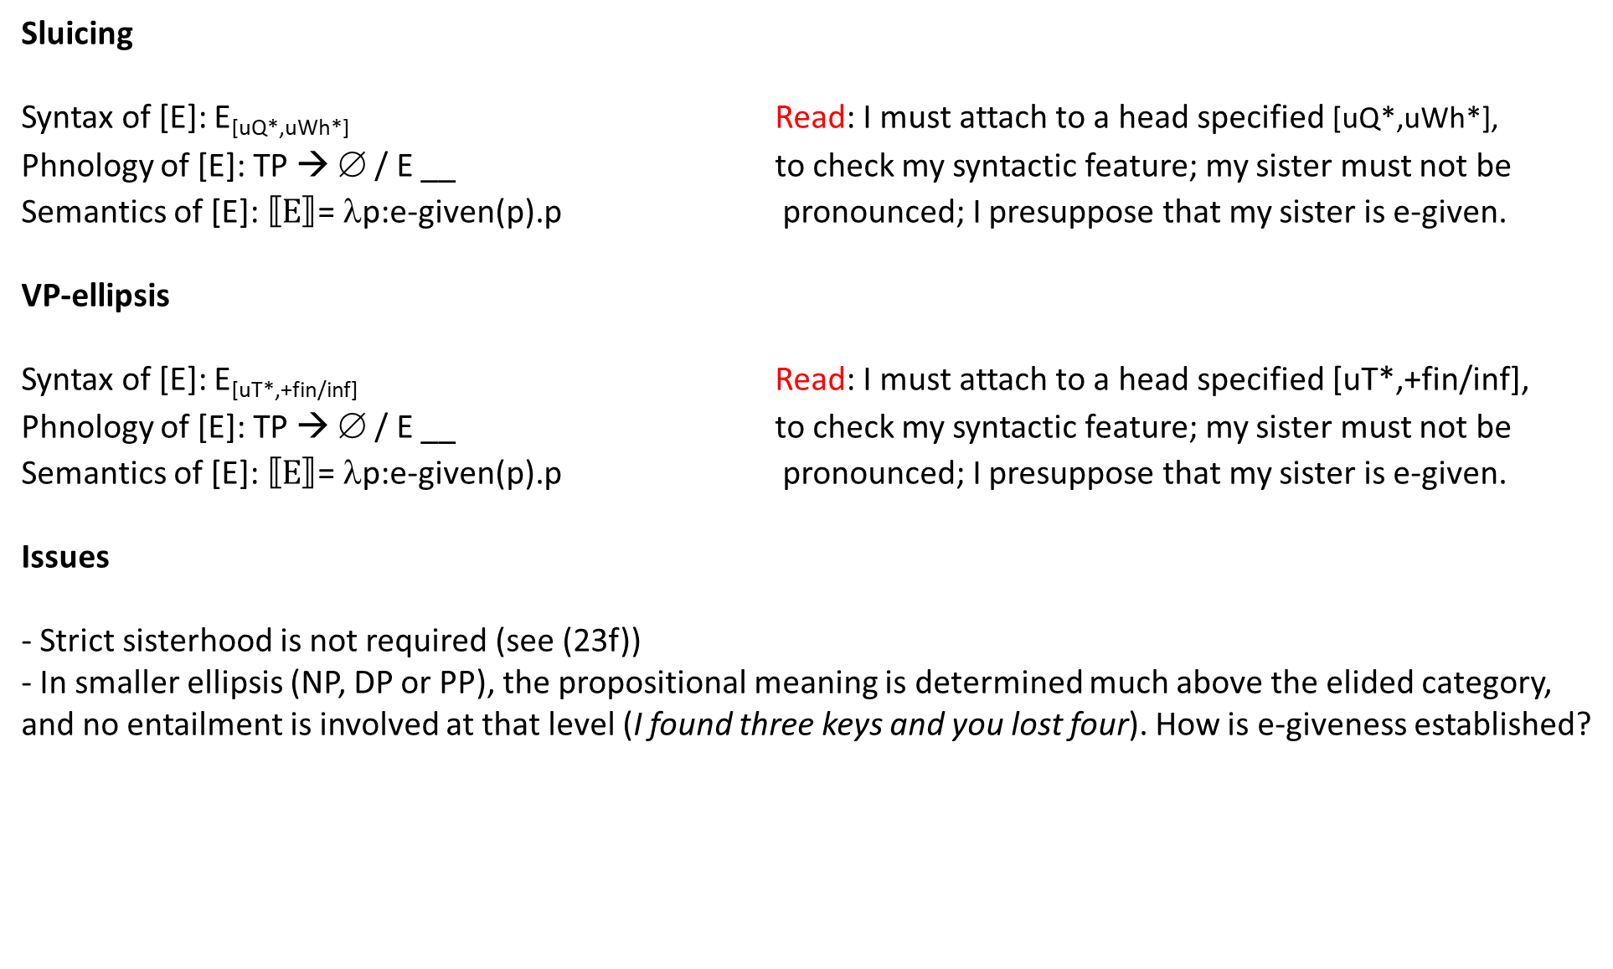
Packaging [E] together
Sluicing
Syntax of [E]: E_{[uQ*,uWh*]} Read: I must attach to a head specified [uQ*,uWh*],
Phnology of [E]: TP → ∅ / E __ to check my syntactic feature; my sister must not be
Semantics of [E]: $⟦E⟧$= λp:e-given(p).p pronounced; I presuppose that my sister is e-given.
VP-ellipsis
Syntax of [E]: E_{[uT*,+fin/inf]} Read: I must attach to a head specified [uT*,+fin/inf],
Phnology of [E]: TP → ∅ / E __ to check my syntactic feature; my sister must not be
Semantics of [E]: $⟦E⟧$= λp:e-given(p).p pronounced; I presuppose that my sister is e-given.
Issues
- Strict sisterhood is not required (see (23f))
- In smaller ellipsis (NP, DP or PP), the propositional meaning is determined much above the elided category, and no entailment is involved at that level (I found three keys and you lost four). How is e-giveness established?

Slide 24
PF-deletion derivation
Jane [_{A} drank some beer] and Bill did [_{E} ___] too.
S-structure: and Bill drank some beer, too
LF: and Bill drank some beer, too
PF: and Bill T_{[+affix]} [drank some beer], too do-support
Things to worry about: How is identity between A and E guaranteed?
Things not to worry about: How to capture morpho-syntactic connectivity between the ellipsis remnant and elided material?
Two theoretical accounts of ellipsis
LF-copying derivation
Jane [_{A} drank some beer] and Bill did [_{E} ___] too.
S-structure: and Bill T_{[+affix]} ∅, too
PF: and Bill T_{[+affix]} ∅, too
do-support
LF: and Bill [drank some beer], too
Things to worry about: (i) How to capture morpho-syntactic connectivity between the ellipsis remnant and elided material? (ii) Cyclicity/Monotonicity/No Tampering.
Things not to worry about: How is identity between A and E guaranteed?
Copy
Delete

Slide 25
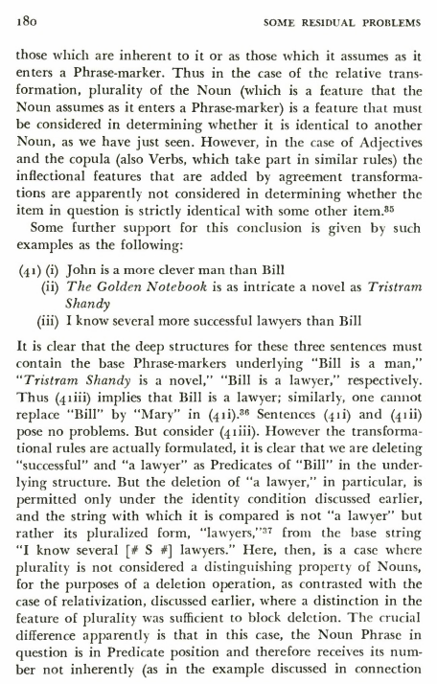
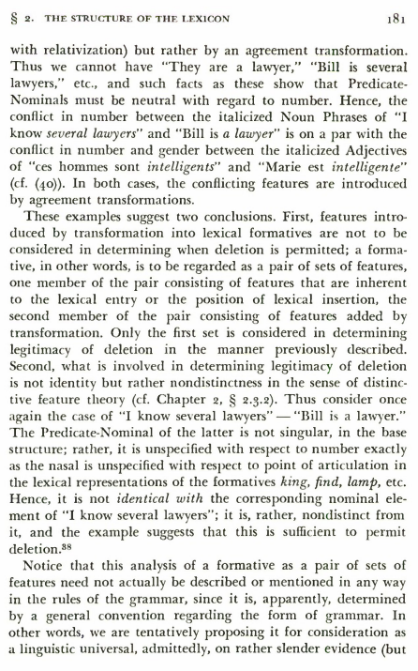
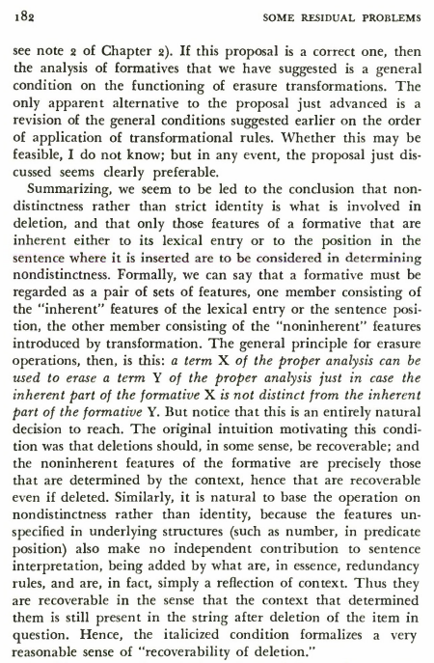
Chomsky (1965) on Recoverability of Deletion.
Recoverability of Deletion

Slide 26
Phonological identity is not sufficient
(28) * Injustices, he rights, but books he doesn’t.
Inflectional mismatches are ignored
(29) a. I’ll fix the car if you tell me how [PRO to fix the car]. [±finite] b. Emily played beautifully at the recital and her sister will [play beautifully], too. [±tense]
(30) a. ata tohav et ha-seret aval ha-xaverim šelxa lo [yohavu et ha-seret]. [φ-features] (Hebrew) you love.FUT.2SG.M ACC the-movie but the-friend your not love.FUT.3PL ACC the-movie
‘You’ll love the movie but your friends won’t.’ b. ba-hatxala nigaš eleynu šoter nexmad aval axar-kax higi’u kama [šotrim] alimim. [φ-features] (Hebrew) in.the-beginning approached to.us cop nice but later arrived.3PL a.few cops violent.3PL
‘First a nice cop approached us but then a few violent ones arrived.’ c. a. John-un caki-uy kay-wa/*lul kotcal sanpo-lul ha-n-ta. Kulena Bill-un [caki-uy kay-lul/*wa] kotcal ttayli-n-ta.
John-TOP self-GEN dog-COM/*ACC often walk-ACC take-PRES-IND but Bill-TOP self-GEN dog-ACC often beat-PRES-IND
‘John often takes a walk with his dog. But Bill often beats his (= Bill’s) dog sloppy → ellipsis
Identity: What does not count
[Case] (Korean)

Slide 27
(31) a. el tío de María y el [tío]/*la [tía] de Pedro the.M.SG uncle of Maria and the.M.SG uncle the.F.SG aunt of Pedro
‘Mary’s uncle and Pedro’s uncle/*aunt’ b. la tía de María y la [tía]/*el [tío] de Pedro the.F.SG aunt of Maria and the.F.SG aunt the.M.SG uncle of Pedro
‘Mary’s aunt and Pedro’s aunt/*uncle’
(32) a. el casamiento de Juan y el [casamiento]/*la [boda] de Pedro the.M.SG marriage of Juan and the.M.SG marriage the.F.SG wedding of Pedro
‘Juan’s marriage and Pedro’s marriage/*wedding’ (despite possible synonymy!) b. la boda de Juan y la [boda]/*el [casamiento] de Pedro the.F.SG wedding of Juan and the.F.SG wedding the.M.SG marriage of Pedro
‘Juan’s marriage and Pedro’s marriage/*wedding’ (despite possible synonymy!)
Spanish data and analysis by Saab (2019)
Gender recoverability in NP-ellipsis
Unrecoverable natural gender
Unrecoverable grammatical (arbitrary) gender

Slide 28
(33) a. el perro de Juan y los [perros] de Pedro the.M.SG dog of Juan and the.M.PL dogs of Pedro
‘Juan’s dog and Pedro’s dogs.’ b. los perros de Juan y el [perro] de Pedro the.M.PL dogs of Juan and the.M.SG dog of Pedro
‘Juan’s dogs and Pedro’s dog.’
(34) a. Beth’s wedding was in Bond Chapel, and Rachel’s [wedding] was in Rockefeller chapel. b. Beth’s nuptials were in Bond Chapel, and Rachel’s [nuptials] were in Rockefeller chapel. c. * Beth’s wedding was in Bond Chapel, and Rachel’s [nuptials] were in Rockefeller chapel. d. * Beth’s nuptials were in Bond Chapel, and Rachel’s [wedding] was in Rockefeller chapel.
Summarizing: Recoverability in NP ellipsis (and possibly in other ellipses) goes beyond semantic synonymy; inherent lexical-syntactic features must be identical between A and E. A structural account (incorporating Chomsky’s original insight) might locate inherent and inflectional features at different heights within DP.
Spanish data and analysis by Saab (2019)
Number recoverability in NP-ellipsis
Recoverable interpretable number
Unrecoverable uninterpretable (pluralia tantum) number

Slide 29
DP
3
D NumP
3
Num_{[E]} nP
3 n √P
[gender] & inherent [number] inflectional [number]
→ Lexical-syntactic features inside E must be identical to those inside A; features outside E are not subject to Recoverability.
Syntactic identity under nP-ellipsis
Consequences of nP-ellipsis
Agglutinative languages: Stranded Case & Number affixes attach to Adj instead of N (which is missing) – Hungarian, Persian, Quechua, Turkish.
Inflectional languages: Number is expressed on the stranded D – Spanish, German.
Consequences of NumP-ellipsis
Mismatch in inflectional number will be excluded; unclear whether this is attested.
Consequences of √P-ellipsis
A stranded n will surface as a pro-form; English one, Afrikaans/Frisian een, Japanese to.
nP-ellipsis

Slide 30
Semantic RoD
E must have a salient A and be e-given.
→ Inflectional features are uninterpretable, hence invisible to RoD.
Syntactic RoD
E must have a syntactically identical, salient A.
→ Inflectional features are specified outside the ellipsis site, or: Ellipsis bleeds valuation at PF (hence, a mismatch does not even arise)
Distinguishing scenarios: [… Antecedent …] … [… ellipsis…]
(A) Different syntax, identical semantics → ✓ellipsis → Semantic identity condition
(B) Different syntax, identical semantics → *ellipsis → Syntactic identity condition
(A) might fall under syntactic identity if the syntactic analysis is abstract enough to be identical!
Identity: Syntax, semantics or both?
(35) I became a lawyer because my
parents were [lawyers/*a lawyer].
Syntactic solution A
… T_{[Num:Pl]} … [t_{Aux} [_{DP} D _{[Num:__]} …]]
Syntactic solution B
[_{DP} D _{[Num:Sg]} …] … [t_{Aux} [_{DP} D _{[Num:__]} …]]
A nondistinct from E

Slide 31
Strict/sloppy ambiguities
(36) a. Paul likes his dog and Mary does too. b. Strict: Paul_{i} like his_{i/k} dog and
Mary likes his_{i/k} dog too. c. Sloppy: Paul_{i} like his_{i} dog and
Mary likes her_{i} dog too.
[Note – the φ-mismatch is ignored]
VP-denotation on the strict reading: λx.x likes p’s dog
VP-denotation on the sloppy reading: λx.x likes x’s dog
Both can count for semantic or syntactic identity (assuming they are distinguishable at LF)
Strict-sloppy ambiguities
Elements that must be bound variables only allow the sloppy reading under ellipsis.
Locally bound reflexives
(37) a. Paul likes himself and Mary does too.
b. Sloppy: Paul_{i} likes himself_{i} and
Mary_{j} likes herself_{j} too.
c. * Strict: Paul_{i} likes himself_{i} and
Mary likes him_{i} too.
Obligatory control PRO
(38) a. Paul hopes to win and Mary does too.
→ b. Paul hopes that he himself would win and
Mary hopes that she herself/*he himself
would win.

Slide 32
(39) a. They arrested Alex_{i}, even though he_{i} thought they wouldn’t ___. b. * They [arrested Alex_{i}], even though he_{i} thought they wouldn’t [_{VP} arrest Alex_{i}].
If the missing VP in (a) is a copy of the antecedent, the R-expression Alex should violate binding condition C.
Proposal: Under referential identity, R-expressions and pronouns are interchangeable in ellipsis.
(40) VP-ellipsis with vehicle change
They [arrested Alex_{i}], even though he_{i} thought they wouldn’t [_{VP} arrest him_{i}].
Different syntax, identical semantics → ✓ellipsis → Semantic identity condition
Problem: Referential identity predicts no asymmetries in vehicle change, but in fact, the change can only lead to a pronoun.
(41) a. Every boy_{i} praised himself_{i} and every boy’s_{i} mother did [praise him_{i}], too. b. *Every boy’s_{i} mother praised him_{i} and every boy_{i} did [praise himself_{i}], too.
Intuition: DPs and reflexives “contain” pronouns (the least specified items); ellipsis requires a subset relation
→ A syntactic condition, weaker than “identity”.
Semantic identity (?): “Vehicle change”

Slide 33
VP-ellipsis tolerates active-passive (Voice) mismatches (note that traces are ignored; more below). So it appears:
Different syntax, identical semantics → ✓ellipsis → Semantic identity condition
(42) a. The system_{i} can be [used t_{i}] by anyone who wants to [use the system]. b. The janitor must [remove the trash] whenever it is apparent that it_{i} should be [removed t_{i}].
But other types of predicate and clausal ellipsis resist this mismatch.
(43) Gapping a. * Some bring roses and lilies by others. b. * Lilies are brought by some and others roses.
(44) Pseudogapping a. * Some bring roses and lilies are by others. b. * Lilies will be brought by some and others will roses.
(45) Sluicing a. *Joe was murdered, but we don’t know who. b. * Someone murdered Joe, but we don’t know by whom.
Voice mismatches and identity
Account: VP decomposes as:
[_{VoiceP} Ext. Arg. [Voice_{[±Active]} [_{vP} v [_{VP} V Obj…]]] ]. VP-ellipsis targets vP; hence, mismatches in VoiceP are not registered. All other elliptical constructions target VoiceP or higher projections, hence they are sensitive to mismatches in the syntactic content of Voice → Syntactic identity condition.
(Note: Gapping might be just ATB V-raising)

Slide 34
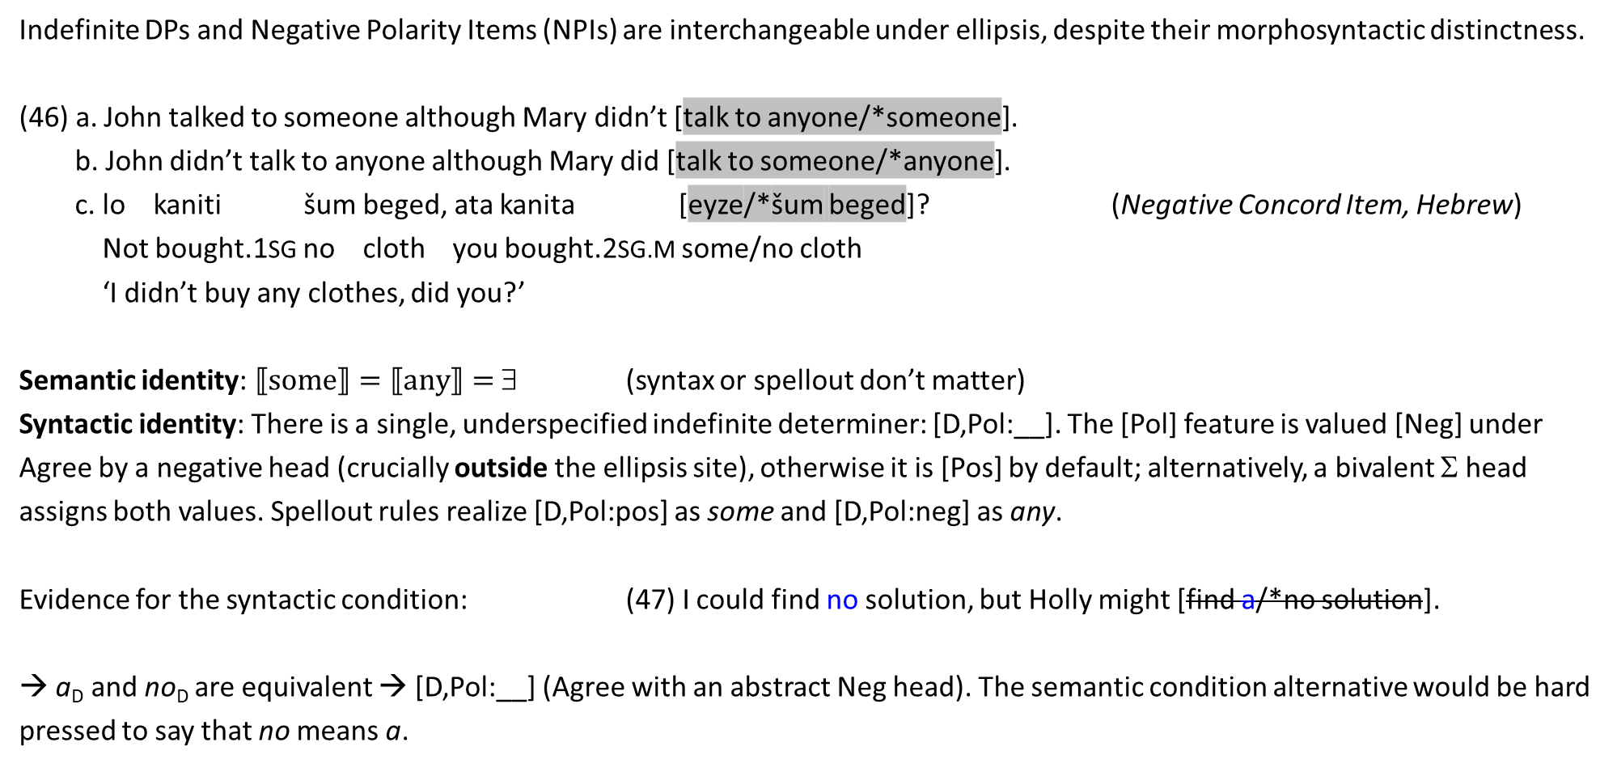
Indefinite DPs and Negative Polarity Items (NPIs) are interchangeable under ellipsis, despite their morphosyntactic distinctness.
(46) a. John talked to someone although Mary didn’t [talk to anyone/*someone]. b. John didn’t talk to anyone although Mary did [talk to someone/*anyone]. c. lo kaniti šum beged, ata kanita [eyze/*šum beged]? (Negative Concord Item, Hebrew)
Not bought.1SG no cloth you bought.2SG.M some/no cloth
‘I didn’t buy any clothes, did you?’
Semantic identity: $⟦some⟧=⟦any⟧=$ ∃ (syntax or spellout don’t matter)
Syntactic identity: There is a single, underspecified indefinite determiner: [D,Pol:__]. The [Pol] feature is valued [Neg] under Agree by a negative head (crucially outside the ellipsis site), otherwise it is [Pos] by default; alternatively, a bivalent Σ head assigns both values. Spellout rules realize [D,Pol:pos] as some and [D,Pol:neg] as any.
Evidence for the syntactic condition: (47) I could find no solution, but Holly might [find a/*no solution].
→ a_{D} and no_{D} are equivalent → [D,Pol:__] (Agree with an abstract Neg head). The semantic condition alternative would be hard pressed to say that no means a.
Negative polarity and identity

Slide 35
Traces in E may correspond to lexical content in A; or to traces with different content.
(48) a. She invited someone; guess who_{i} [she invited t_{i}]. b. He has 5 CATS, but I forget how many DOGS_{i} [he has t_{i}]. c. John likes ACTION movies. Comedies_{i}, he doesn't [like t_{i}]. d. MORPHOLOGY_{i}, I like t_{i}, but PRAGMATICS, I don’t [like t_{j}]. e. The system_{i} can be [used t_{i}] by anyone who wants to [use the system]. f. A: Where_{j} have_{i} [_{TP} you t_{i} been t_{j}]? B: She knows where_{k} [_{TP} I have been t_{k}].
Semantic condition (incorporating e-giveness): Traces are variables; If the moved element lands outside the ellipsis domain, the variable is existentially bound (∃x.she invited x). Focused elements are also replaced by variables that are similarly ∃-bound , guaranteeing identity (but in (f), the head-trace isn’t an individual variable, and the lexical correspondent isn’t focused).
Syntactic condition: For any chain that crosses an ellipsis domain, X_{i} … [_{α} … t_{i} …], t_{i} is ignored for identity. Rationale: Ellipsis operates on material before it is silenced, but a trace is already silenced.
Traces and identity

Slide 36
Recent work suggests that in clausal ellipsis, the antecedent and target could differ in inflectional features that do bear semantic content → some aspects of the meaning of an ellipsis site are not recoverable, and yet the ellipsis is licensed.
Mismatches in sluicing (TP ellipsis)
(49) a. Your favorite plant is alive, but you can never be sure for how long_{i} [it will be alive t_{i}]. Tense mismatch b. Sally said that customers should be given lower rates, but Susi said it’s hard to see Modality mismatch how_{i} [customers could be given lower rates t_{i}]. c. ‘Coach O’Leary doesn’t do things without telling you why_{i} [Coach O’Leary did those things t_{i}],’ Polarity mismatch
Hamilton said.
Mismatches in CP ellipsis (note the extraction)
(50) ani lo zoxer im hem nas’u le-YAVAN, (Force mismatch, Hebrew)
I not remember if they travelled to-Greece aval le-ITALYA_{i}, ani dey batuax [še-/*im hem nas’u t_{i}]. but to-Italy I quite sure that-/*if they travelled
‘I don’t remember if they travelled to Greece, but to Italy, I’m quite sure they did.’
Challenges to identity
Proposal: Syntactic identity applies to a subdomain of the ellipsis domain – specifically, to the lexical core. Functional mismatches are tolerated (with enough pragmatic support).

Slide 37
Aux-stranding VP-ellipsis
(51) a. Ted was being noisy, and Robin was (*being) too. → AuxP associated with ProgP must be included in VPE. b. Julie is working hard lately and Suzan is too.
… [_{TP} Suzan [_{T'} is_{j}-T [_{AuxP} t_{j} [_{ProgP} -ing [_{vP} work hard lately ]]] ]
V/Aux-stranding TP ellipsis (Polarity Ellipsis)
(52) A: Ar chuir tú isteach ar an phost? (verb-echo reply, Irish)
INTERR.PAST put.PAST you in on the job
'Did you apply for the job?’
B: Chuir. put.PAST
'Yes.’
(53) A: Meg hívta János a szomszédokat? (VM= verbal modifier, Hungarian)
VM invited János the neighbors
'Did János invite the neighbors?’
B: Meg (hívta). [_{PolP} [V-T]_{j}-Pol [_{TP} Subject [_{T’} t_{j} [_{VP} t_{i} Object ]]] ]
VM invited
'He did.'
Head-stranding ellipsis

Slide 38
Prediction: If a language allows both X-movement and XP ellipsis, it should also allow X-stranding XP ellipsis.
Puzzle: A number of languages have the ingredients but not the outcome: Hebrew, Russian, Hindi, and (more controversially), Portuguese and Japanese. We’ll look at Hebrew.
(54) a. Gil [_{V} šaxax] [_{Adv} le-itim krovot] t_{V} et ha-maftexot ba-oto. ✓V-to-T movement
Gil forgot to-times frequent ACC the-keys in.the-car
'Gil often forgot the keys in the car.’ b. A: Gil haya maskim la'azor lanu?
Gil was agree.PRTC to.help to.us
'Would Gil have agreed to help us?’
B: Batuax hu haya __. ✓Aux-stranding VP ellipsis surely he was
'Surely he would have.'
A curious lacuna: V-stranding VP ellipsis

Slide 39
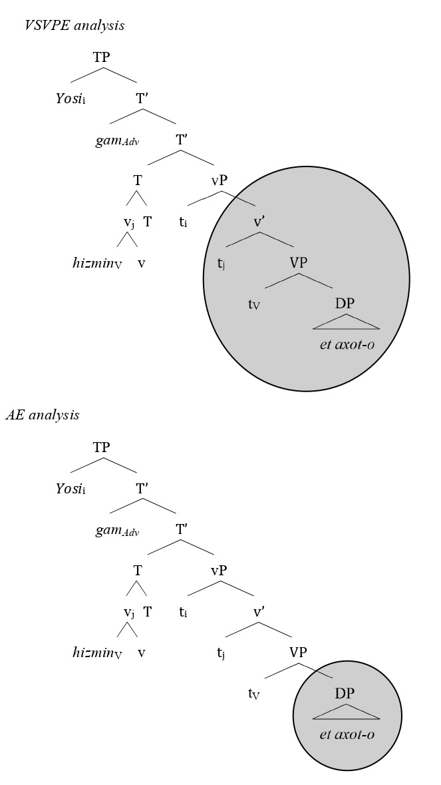
Argument Ellipsis vs. V-stranding VP ellipsis
Missing objects in Hebrew can be elliptical. This is seen most
clearly when they give rise to readings not expressible by (null) pronouns (Landau 2018 provides many kinds of such objects).
55. A: ani mexapes šloša ozrim la-misrad.
I look.for three assistants to.the-office
‘I’m looking for three assistants for my office.’
B: ani lo carix ___, maspikim li šnayim.
I not need suffice.3PL to.me two
‘I don’t need three (assistants), two are enough for me.’
[cf. # I don’t need them…]
The question is: Ellipsis of what? Given that Hebrew has both V-to-T and VPE, it can generate elliptical object gaps in two ways.
56. Gil hizmin et axot-o. Yosi gam hizmin ___.
Gil invited ACC sister-his. Yosi too invited
‘Gil invited his sister. Yosi did too.’

Slide 40
VSVPE undergenerates (hence, is insufficient):
Missing object without a VP antecedent
Missing single object in ditransitives
VSVPE overgenerates (hence – is falsified):
Adjunct-including readings
Missing “non-canonical” objects
Missing object without a VP antecedent
57. A: adayin eyn li manxe la-doktorat. still no to.me advisor to.the-doctorate
'I still don't have a PhD advisor.’
B: lifney ­še-ata moce ___, ata carix nose. before that-you find you need topic
'Before you find one, you need a topic.'
In favor of AE and against VSVPE - I
Missing single object in ditransitives
VSVPE, like any VPE, should elide both arguments. If one argument survives, it is either because (i) AE is at work, not VSVPE, or (ii) the surviving argument scrambles out of VP before VSVPE (like the verb does). We can rule out (ii) by using “unscrambleable” reflexives.
58. a. hišveti et roš ha-memšala
compared.1SG ACC head the-government
le-acmo (me-lifney šnatayim).
to-himself (from-before two.years)
‘I compared the prime minister to himself
(from two years ago).’ continued…

Slide 41
In favor of AE and against VSVPE - II
58. b. * hišveti le-acmo et roš
compared.1SG to-himself ACC head
ha-memšala(me-lifney šnatayim).
the-government (from-before two.years)
c. A: le-mi hišveta et roš
to-whom compared.2SG.M ACC head
ha-memšala?
the-government
‘Who did you compare the prime
minister to?’
B: (hišveti) ___ le-acmo.
compared.1SG to-himself
‘I compared him to himself.’
Adjunct-including readings
VPE can include adjuncts, as seen most clearly under negation:
59. Dana read the article quickly, but Ron didn’t___.
He read it slowly.
VSVPE should also give rise to such readings, but in fact, object gap sentences in many languages for which VSVPE has been proposed exclude the adjunct: This is true of Hebrew, Japanese, Turkish, Chinese, Persian, etc.
underivable by VSVPE

Slide 42
60. Bill-wa kuruma-o teineini aratta. John-wa ___ arawa-nakat-ta. (Japanese)
Bill-TOP car-ACC carefully washed John-TOP wash-not-PAST
‘Bill washed the care carefully. John didn’t wash the car.’
61. a. Yosi afa et ha-uga lefi ha-matkon. hi hayta me’ula. (Hebrew)
Yosi baked ACC the-cake according the-recipe it was fabulous
‘Yosi baked the cake according to the recipe. It was fabulous.’ b. Gil lo afa ___. # hi hayta mag’ila. AE adjunct not included
Gil not baked it was gross
‘Gil didn’t bake the cake. # It was gross.’ c. GIL, LO ___. hi hayta mag’ila. Stripping (TP-ellipsis) adjunct included
Gil not it was gross
‘Gil didn’t. It was gross.’
*Adjunct-including readings

Slide 43
If XP is the target of ellipsis, we might expect ellipsis to be sensitive to properties of XP; but we don’t ellipsis of XP to be sensitive to properties of some YP internal to XP. If we do – it indicates that YP is the target of ellipsis.
Constraint on Argument Ellipsis
Only arguments of type <e> can be elided.
Evidence: Hebrew, Brazilian Portuguese, Japanese, Chinese, Korean
Unelidable arguments
⬧ Idiom chunks (non-decomposable)
⬧ Argumental adverbs
⬧ Measure arguments
⬧ Names in naming verbs
⬧ Predicate nominals
⬧ Generalized quantifiers
AE and “non-canonical” objects
The challenge: How to explain the constraint without compromising the Autonomy of Syntax (rules of syntax, or of the syntax-PF mapping, cannot make reference to semantic types)?

Slide 44
(62) * Yosi hitnaheg yafe aval axiv lo hitnaheg ___. (Hebrew, argumental adverb)
Yosi behaved.3M.SG well but brother.his not behaved.3M.SG
('Yosi behaved well but his brother didn't.')
(63) A: Na-nun mommwukey-ka 70 killo naka.
I-NOM weight-NOM 70 kilos weigh
‘I weigh 70 kilos.’
B: * O! nay-ka mommwukey-ka ___/kukes nakan-ci kkoay toy-ess-ne. (Korean, measure phrase) Oh I-NOM weight-NOM it weigh-since pretty become-PST-DEC
(Intended: ‘Oh, it’s been a long time since I did.’)
(64) Wo jiao Binbin; ta ye jiao *(Binbin). (Chinese, name in naming verb)
I call Binbin he also call Binbin
‘I am named Binbin; he is also named *(Binbin).’
*AE of non-<e>-type objects

Slide 45
First, object gaps in this class of languages are not derived by any type of “large ellipsis”, of either VP or TP, which are consistently indifferent to the semantic type of the object.
65. a. Mary behaved politely but her sister didn’t ___. b. Paul weighed 70 kilos before you did ___. c. We named our cat Rudolph, but not our dog ___.
Proposal: Elided arguments are generated as (or associated with) syntactic variables. Such variables are known to be restricted to type <e> (Landman 2006, Poole 2024; see anti-reconstruction effects).
Option I: pro-replacement Option II: “Big DP” apposition pro [D_{[E]} DP] type <e>
DP [D_{[E]} DP]
Towards an explanation of AE

Slide 46
Another context where head raising out of an ellipsis site is impossible: Aux-inversion in English matrix sluicing.
66. A: Mary has dated someone.
B: Who (*has)?
C: [_{CP} Who [_{C’} has_{i}-C [_{TP} [Mary [_{T’} t_{i} dated]]]]?
D: *Who Mary has dated?
Option I: Sluicing is C’-deletion
Problems: (i) nonmaximal projections are “invisible”;
(ii) The licensor head must be external to the ellipsis.
Option II: T-to-C occurs at PF, TP-deletion bleeds it
Problem: There’s evidence that T-to-C enhances the scope of Neg and modals.
Option III: TP-deletion removes the “defective” feature that must be checked in C.
Problem: PF “well-formedness” driving syntactic movement
Towards an explanation of the absence of VSVPE
Identifying the culprit
UG bans some instances of X-stranding XP-ellipsis
*[_{YP} ZP [_{Y'} [_{Y} X_{i}-Y] [_{XP} t_{i} [_{WP} … ]]]]
Though not always! See (51)-(53).
Instead of ellipsis blocking head-movement, perhaps it is head movement blocking ellipsis: To execute ellipsis of certain XPs, the head X must be “PF-visible” (rather than a trace).

Slide 47


